Slide 1
The Constitution
The Constitution was written at the Constitutional Convention in Philadelphia. It was completed on September 17, 1787 – Constitution Day.

Slide 2
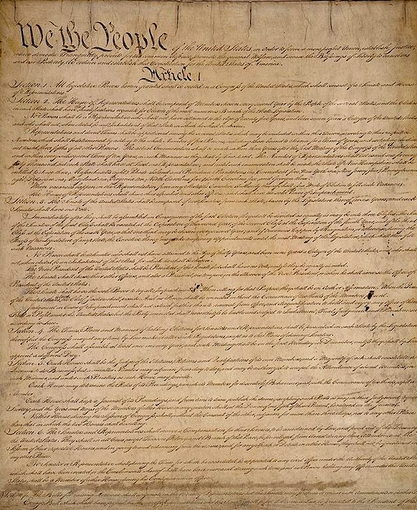

Slide 3
Constitution Quiz
At the age of 18, will you have the same voting power as the President, Donald Trump, and Jay-Z?
Yes

Slide 4
Constitution Quiz
Will you automatically get a free lawyer if you are charged with a crime?
Yes

Slide 5
Constitution Quiz
Can you peacefully criticize the government by writing, speaking and organizing?
Yes

Slide 6
Constitution Quiz
Can the police search your house without a very good reason?
No

Slide 7
All of these rights come from the Constitution.

Slide 8
The Constitution gives us the rules (laws) for the whole country, just like Mrs. Tuttle’s rules are the rules for this classroom.

Slide 9
The Constitution also tells us what rights and privileges we have as Americans.

Slide 10
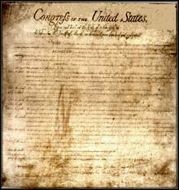
Some of our rights are listed in the Bill of Rights,
which is a part of the Constitution.

Slide 11
Imagine…
HELP!

Slide 12
How will you make sure that anyone who feels unfairly treated will have a place to air complaints?

Slide 13
How will you make sure that people can have peace and quiet?

Slide 14
How will you make sure that group members will help if outsiders arrive who threaten your group?

Slide 15
How will you make sure that the improvements you make on the island (such as shelters, fireplaces and the like) will be used fairly?

Slide 16
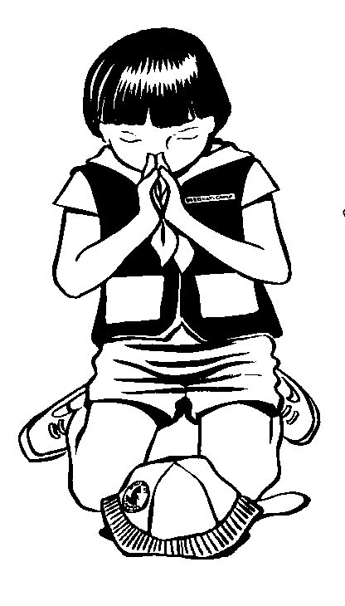
How will you make sure that group members will be free to do what they want as long as it doesn't hurt anyone else?

Slide 17
How will you make sure that the rules and organizations you develop protect future generations?

Slide 18
The founding fathers had to think of all of these questions, too. That’s why they wrote the Constitution.

Slide 19
Preamble:
The introductory part of a constitution or statute that usually states the reasons for and intent of the law.

Slide 20
We the People of the United States, in order to form a more perfect Union, establish justice, insure domestic tranquility, provide for the common defense, promote the general welfare, and secure the blessings of liberty to ourselves and our posterity, do ordain and establish this Constitution for the United States of America.

Slide 21
We the People…
All the people should work together to make decisions that are fair for everyone.
In the United States, the power rests with the people. That makes the U.S.A. a democracy.

Slide 22
…in order to form a more perfect union…
To make the best country (or island) that we possibly can.

Slide 23
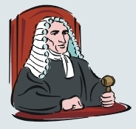
…establish justice…
To make sure that anyone who feels unfairly treated will have a place to air complaints.

Slide 24
…insure domestic tranquility…
To make sure that people can have peace and quiet, and can get along at home, or in their home country.

Slide 25
…provide for the common defense…
To make sure that group members will help if outsiders arrive who threaten your group.
In the United States, we provide for the common defense by having a military.

Slide 26
…promote the general welfare…
To make sure that the improvements you make on the island (such as shelters, fireplaces and the like) will be used fairly.
In the United States, promoting the general welfare means making sure that all Americans have basic needs (food, shelter, education).

Slide 27
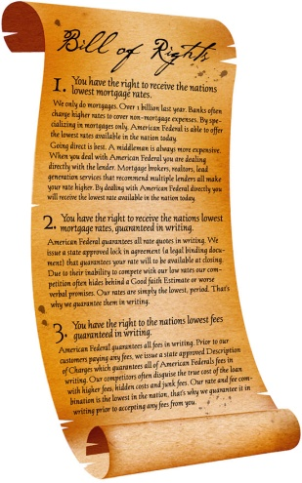
…and secure the blessings of liberty to ourselves…
To make sure that group members will be free to do what they want as long as it doesn't hurt anyone else.
This includes important freedoms such as freedom of speech, religion, assembly, petition, and the press.

Slide 28
…and our posterity…
To make sure that the rules and organizations you develop protect future generations.

Slide 29
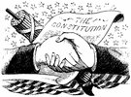
…do ordain and establish this constitution for the United States of America.
This part just means the reasons listed are why the Constitutional Convention decided to create the new Constitution.

Slide 30
We the People of the United States, in order to form a more perfect Union, establish justice, insure domestic tranquility, provide for the common defense, promote the general welfare, and secure the blessings of liberty to ourselves and our posterity, do ordain and establish this Constitution for the United States of America.

