Slide 1
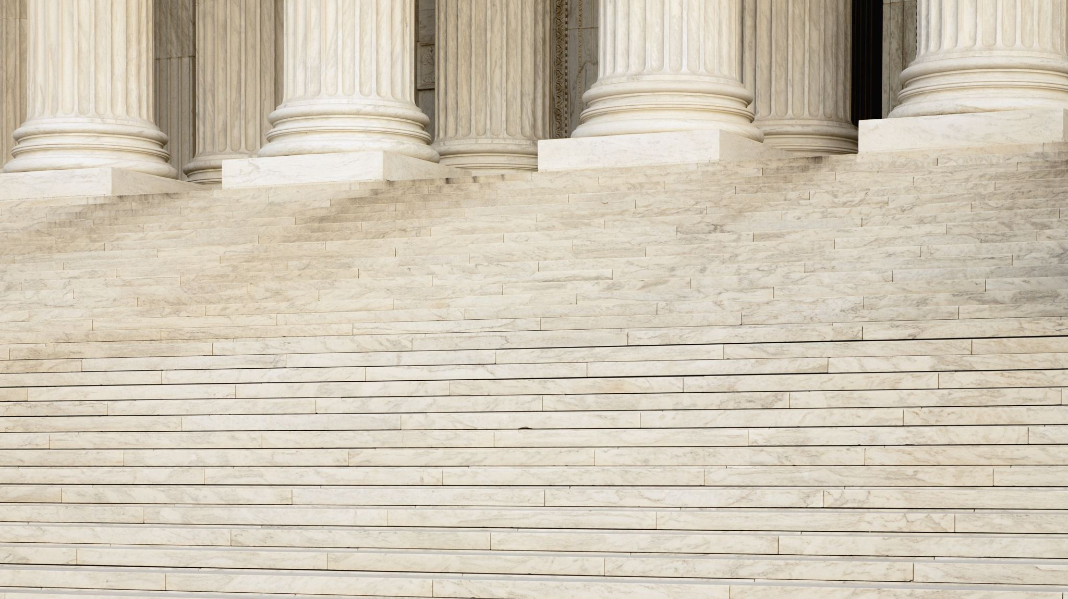
Santa Clara County Superior Court Equality and Social Justice Committee

Slide 2
How Did Our Committee Start?
Chief Justice delivered a powerful statement
Crucial Conversation
Powerful Discussion
Comprehensive Approach
Notes:
Chief Justice/Cal Supes powerful statements right away
Greater Vision – Beyond the Rule
- Not just conform to the rule but conform to the rule but Transform the Environment
Crucial Conversation – Response to George Floyd killing/Civil Unrest
Powerful Discussion – Share content of the training

Slide 3
ESJ Committee is Transformative
This purpose of the ESJ committee is to eliminate all inequities and disparities in our court system.
This committee recognizes the impact of historical social injustices and systemic racism. This committee is committed to achieving an equitable system of justice for all. This committee will cultivate inclusivity, diversity, racial representation, and raise self-awareness through education, crucial conversations, community collaboration and legislation.
Notes:
We don’t want just to conform to a rule
We want to transform our court to seeing everything through the eyes of Equality and Social Justice

Slide 4
First Steps
Personal Conviction
Hesitation
Firestarter
Support
Notes:
Initial Planning –
I was moved on a personal level – Called SVB – Exp resonated – tell why – Felt safe space - Wanted to keep it going
I was hesitant – why – vulnerability - responsibility
Organic Firestarter – So many called – Each court diff
Called PJ – very supportive – strike now

Slide 5
Membership
Who’s involved
How were they selected
Notes:
Who’s involved – Whoever wants to participate – not appt
The largest committee on our court – 47 out of 74 participants
How were they selected – Not selected invited - inclusivity

Slide 6
Establishing Sub-Committees
Which Sub-Committees – Why?
Notes:
Subcoms b/c it’s too much – too many areas
Survey to determine interest areas
Empower people to participate in areas of interest
Co-Chairs were selected from area of interest
Show slides of sub com
Co-Chairs are key/active

Slide 7
Infrastructure
The purpose of this subcommittee is to identify, develop and implement plans to address internal culture, policies and practices that support inequalities.
Notes:
Infrastructure - Elimination of Bias - Rule 10.20 –

Slide 8
Rule 10.20 – Elimination of Bias
Notes:
Update: 2018 Work Group

Slide 9
Education
The purpose of this subcommittee is to raise awareness among judicial officers on issues of equality and social justice. This committee will continue the Crucial Conversations series and others educational workshops and forums to accomplish this goal.
Notes:
Most important – Educate the bench
Education - Crucial conversations – inter-racial/Bystander Intervention/Anti-Hate
Supports Rule 10.20 – The basis of the rule is to educate on bias – The more we are aware of our biases the better judicial officers we will be

Slide 10
Community Outreach
The purpose of the subcommittee is to engage and collaborate with local communities to identify and address inequalities. This committee will host educational forums/conferences on topics relating to equality and social justice to strengthen ties with the community.
Notes:
Community – Community Convo – stake-holders
This committee supports Rule 10.20 - keeps us accountable to the community we serve – Allows us to see how we are being perceived

Slide 11
Legislation
The purpose of this subcommittee is to identify, and Track information about legislation that affects the court system, including any justice reforms legislation.
Notes:
Legislation committee reviews and highlights important legislation that effects Equality and Social Justice
Racial Justice Act and AB 3070 which requires us to consider Implicit Bias during jury selection

Slide 12
Leadership
The purpose of this sub-committee is to promote diversity and inclusivity in the management of our court. This committee will establish, develop and support a leadership program for diverse individuals who are interested in management and supervision.
Notes:
Leadership – PJ’s
Summer Panel Discussion

Slide 13
Recruitment
The purpose of this subcommittees is to explore and provide avenues for bench officers to educate, inform and recruit diverse candidates to become judicial officers.
Notes:
Recruitment – Minority Mentorship/LA Program

Slide 14
Opposition
No overt opposition
Not everyone is on board
How to stay resilient

Slide 15
Closing Thoughts
Notes:
Proud of our bench/State
Statewide dialogue
We’re here to support – provide docs
We’re in this together

