Slide 1
Our System of Government
Notes:
Learning Objectives
By the end of this module, participants should be able to:
List the scope of responsibility for each branch of government
Compare and contrast the jurisdiction of federal and state government
Describe the evolution of the California Court System and its history

Slide 2
Whose Business Is This???
?
Notes:
Ask the participants to complete the quiz individually.
DON’T debrief exercise at this point. Tell them to put it away for a little while until they hear the lecture. You will go back to the results after you are done giving them the theory.

Slide 3
Our Government
Federal Government
State Government
Notes:
Note the two levels of government and point out that there are some similarities and some differences.
The United States is not a collection of purely geographic boundaries. The people who wrote the Constitution and thereby set up our system of government (Alexander Hamilton, James Madison, John Jay, etc.), the framers, intended for each State to be a separate sovereign. The Union was a union of those distinct sovereign States. “Federalism” is the notion of the constitutional relationship between these State governments and the federal government of the United States. Balance of representation of small and large states reflected in number of Senators, for example – a function of fairness to each State.

Slide 4

Federal Law / State Law
Marriage laws?
ICWA?
Possession of 1 gram of methamphetamine?
Importing cocaine?
Immigration?
Notes:
Se we as citizens of both the United States and the State of California are beholden to two sets of laws.
Federal law: some things are a matter of national concern (not that they’re more important than other things), but these things have to do with the United States as a country, its borders, things that happen across state lines or affect the country as a whole.
State law: other things are more appropriate for states to decide.
Quiz—federal or state law:
Marriage laws?
ICWA?
Possession of 1 gram of methamphetamine?
Importing cocaine?
Immigration law?

Slide 5
Our Government
The Division of Powers
Legislative
Executive
Judicial
Notes:
How the balance of power works in our government.
Go over the organizations at the federal level.
Go over the handouts after talking about each CA branch.
Exec: Enforces
Legislature: Makes laws
Judicial: Interprets the law.

Slide 6
The California Court System

Slide 7
A Unified Court System
June 2, 1998 - passed by constitutional amendment
One level of trial courts
Provide efficient use of resources
Improve service to the public

Slide 8
The California Courts
Supreme Court
Court of Appeal
Superior Court
Notes:
Superior (Trial) Court
A court of original jurisdiction where the evidence is first received and considered
Appellate Court
A court with jurisdiction to review decisions of lower courts or administrative agencies
California Courts of Appeal
Six Districts
Some districts have multiple Divisions
Sit in three-justice panels
California Supreme Court
One Chief Justice
Six Associate Justices

Slide 9
Types of Courts: A Comparison
State Courts
Federal Courts
California Supreme Court
Court of Appeal, First Appellate District
Superior Court of California, County of San Francisco
United States Supreme Court
Court of Appeals, Ninth Circuit
United States District Court, Northern District of California
Notes:
At the trial court level, federal courts are divided into districts; California superior courts are organized by county.
At the appellate court level, federal courts are divided into circuits; California courts are divided into appellate districts.
See next slide for map of federal appellate circuits and California appellate districts.
*Fun fact re: origin of “circuit” courts

Slide 10
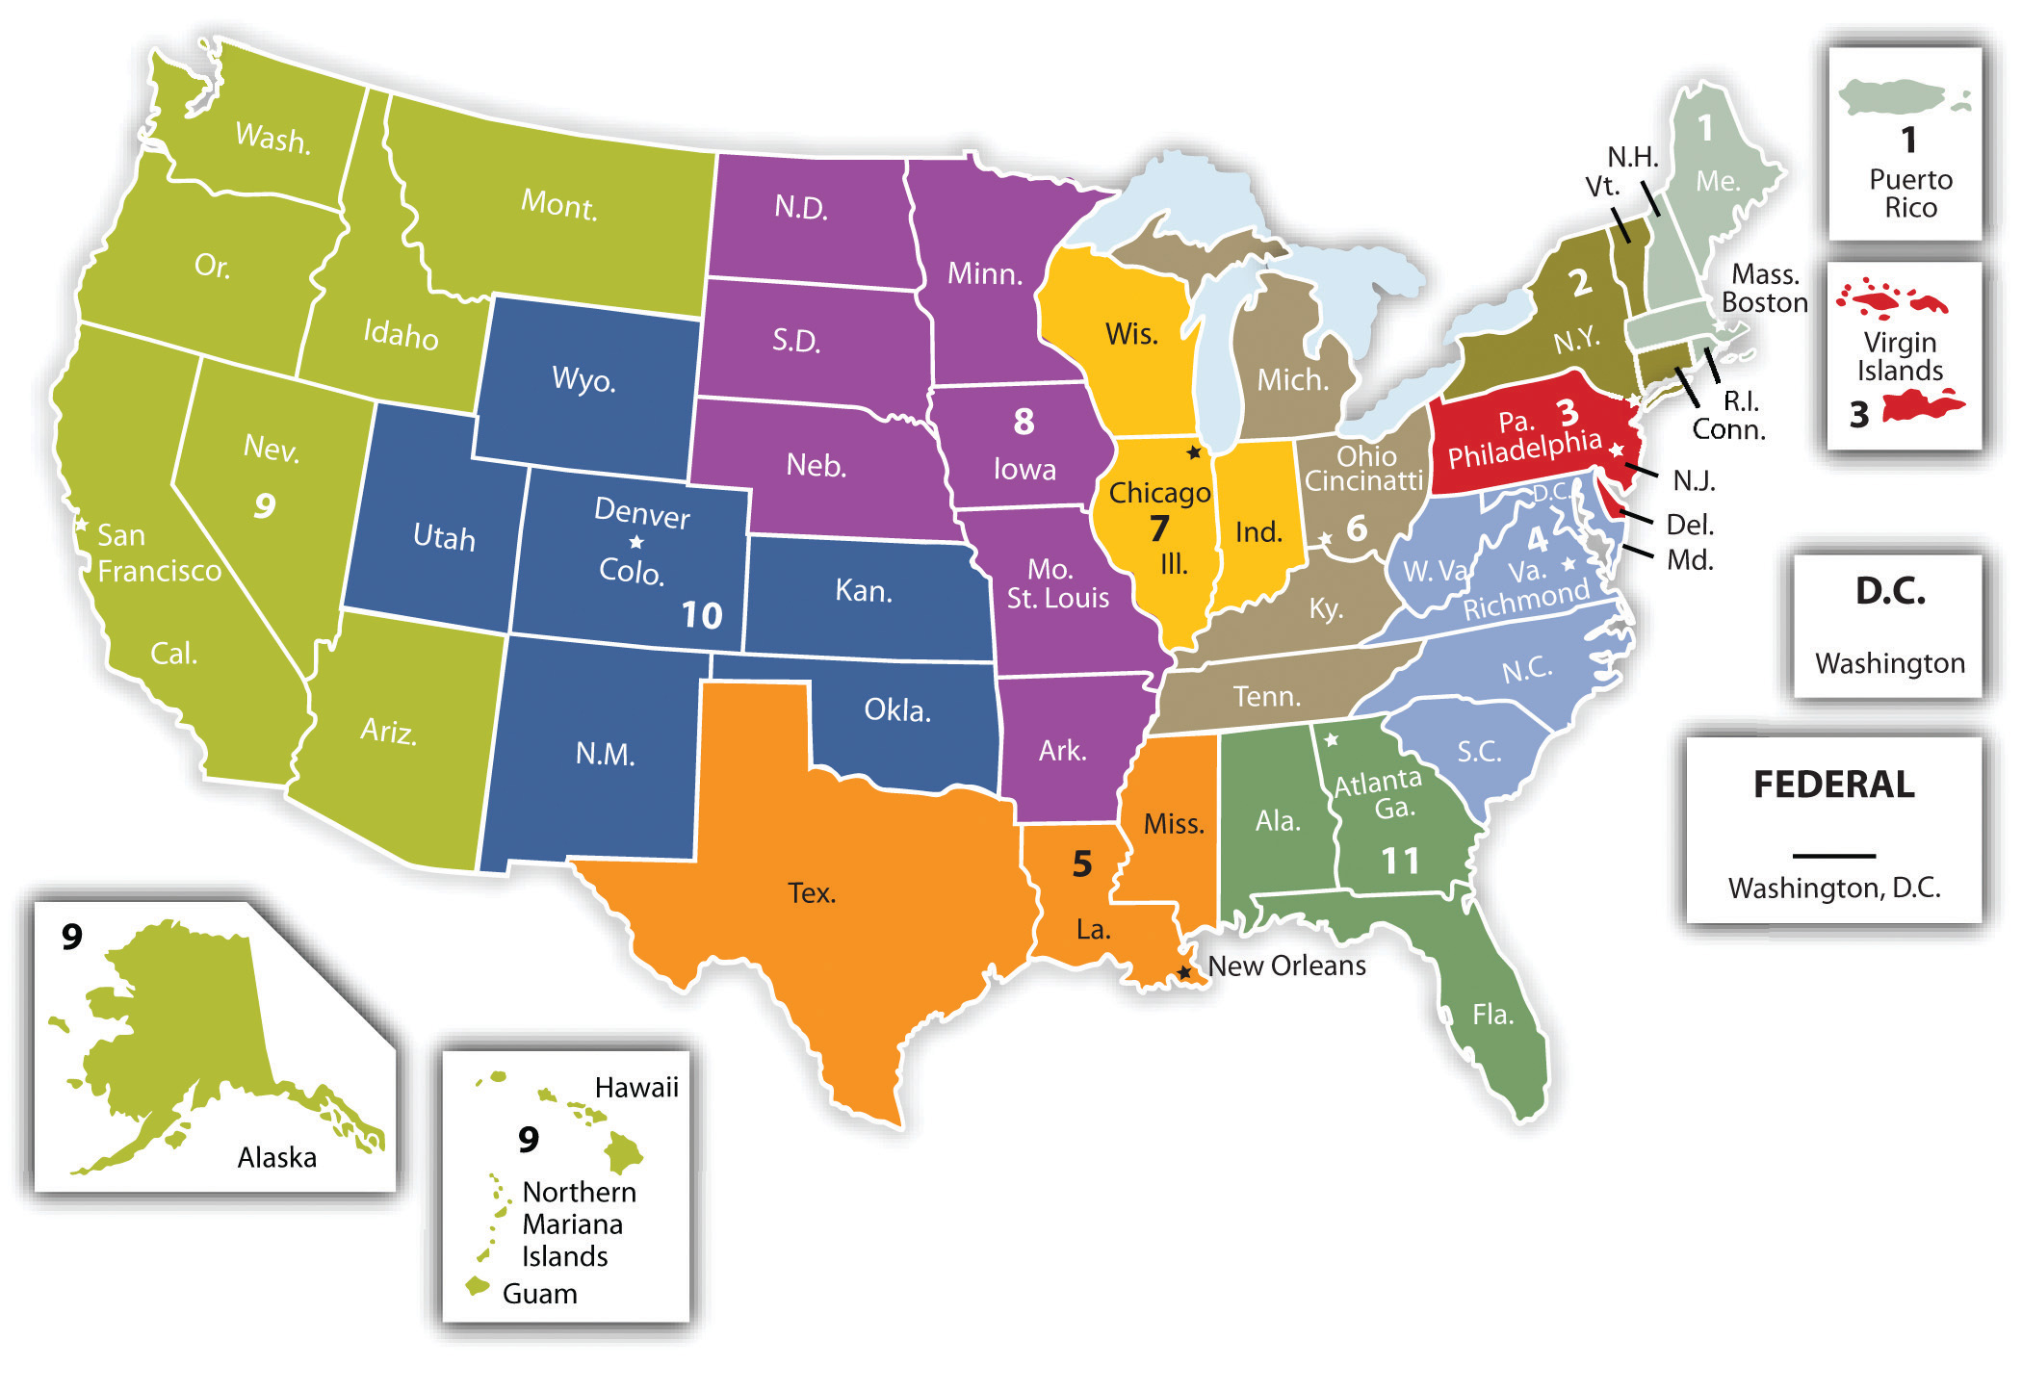
Federal Appellate Circuits

Slide 11
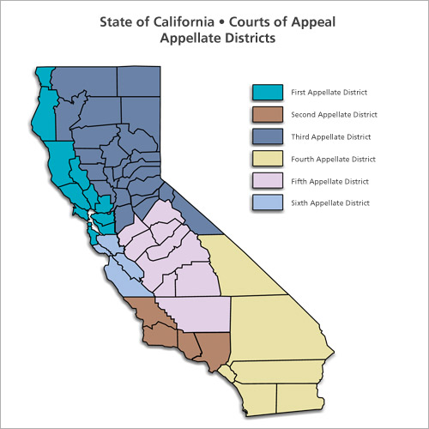

Slide 12
Types of Courts: A Comparison
Superior Court
Court of Appeal
Civil or criminal
Hears issues of law and fact
One judge
Witnesses
Evidence
Jury possible
Civil or criminal
Hears issues of law only
Multi-justice panel
No witnesses
No evidence allowed
No jury
Notes:
Trial court:
Jurisdiction over both civil and criminal matters
One judge presides
Hears witnesses
Can have a jury
Can receive testimonial, physical, and other evidence
Appellate Court:
Multi-justice panel
Jurisdiction over both civil and criminal matters
Hears no witnesses
Has no jury
Does not receive evidence
Requires written briefing
Has limited original jurisdiction

Slide 13
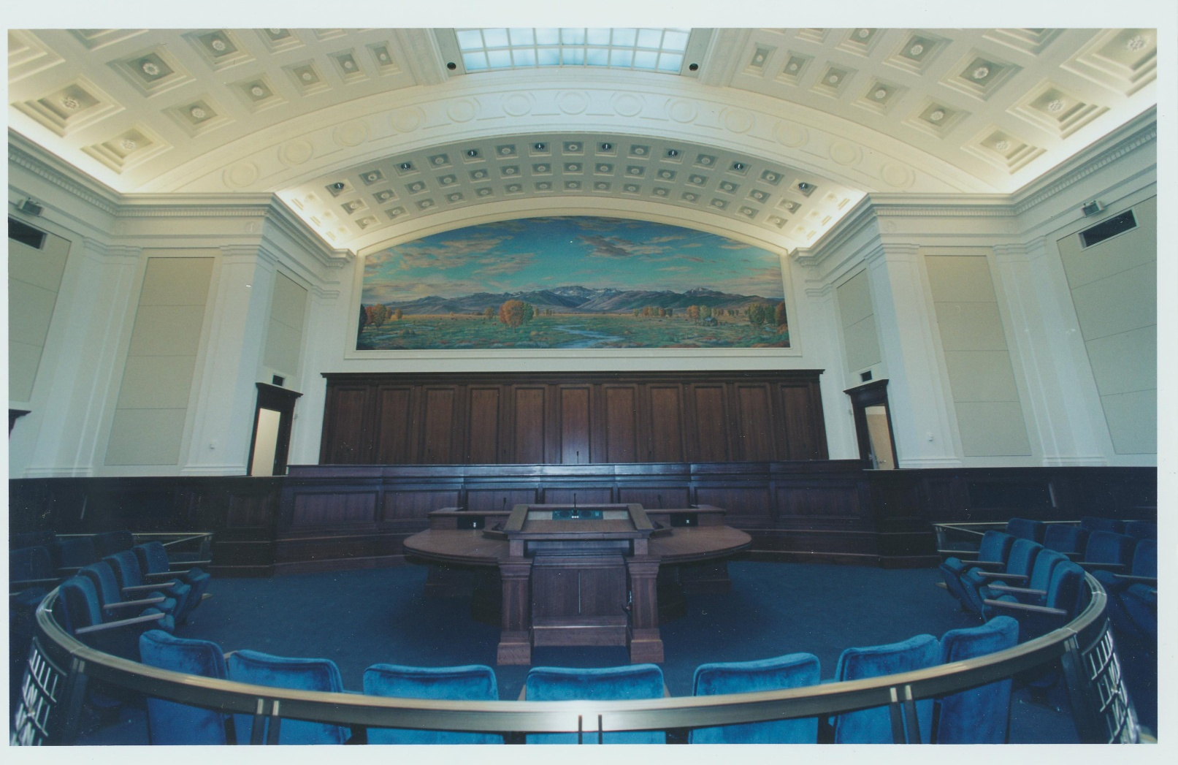
Supreme Court
Notes:
Ask the participants to highlight key distinctions between Appellate and Trial Courts.
Describe all components of the room.
“Pass the Bar” – when a lawyer can “pass” it.

Slide 14
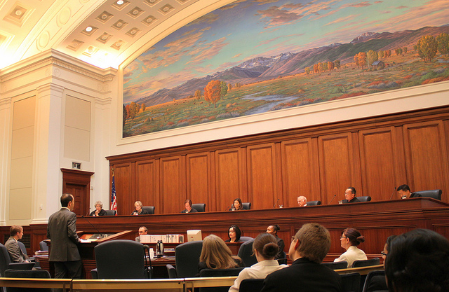
Supreme Court
Notes:
Ask the participants to highlight key distinctions between Appellate and Trial Courts.
Describe all components of the room.
“Pass the Bar” – when a lawyer can “pass” it.

Slide 15
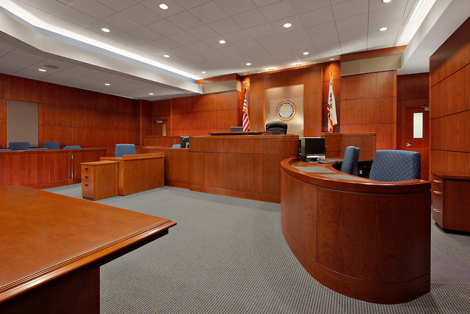
Superior Court

Slide 16
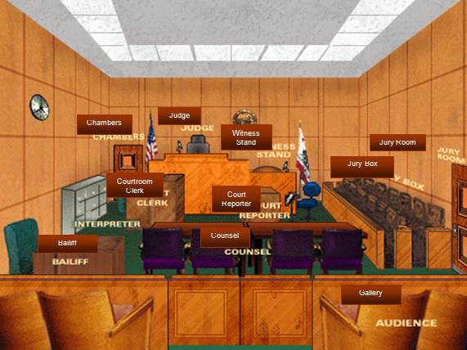
Superior Court

Slide 17
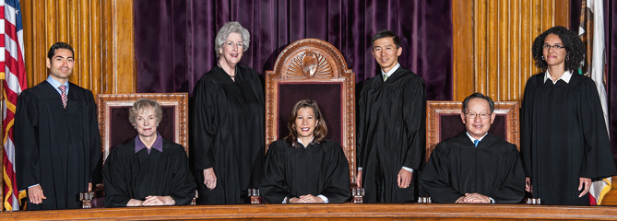
The CA Supreme Court
One Chief Justice
Six Associate Justices
Notes:
Chief Justice Tani Cantil-Sakauye
Associate Justices:
Mariano-Florentino Cuéllar
Kathryn Mickle Werdegar
Carol A. Corrigan
Goodwin H. Liu
Ming W. Chin
Leondra R. Kruger

Slide 18
Types of Cases: A Comparison
Civil
Initiated by ANYONE (individual, corporation, or governmental entity)
Criminal
Initiated ONLY by a governmental entity
Seeks money or change of behavior
No 5th amendment privilege
No right to free lawyer
Preponderance of the evidence
Seeks to protect, punish & rehabilitate
Right to remain silent
Right to legal counsel
Beyond a reasonable doubt
Notes:
Remind people they have a full-size color copy of this chart in their binders.

Slide 19
Our Government
&
The California Court System
Notes:
Who’s Business Is This??? Return to quiz.

