Slide 1
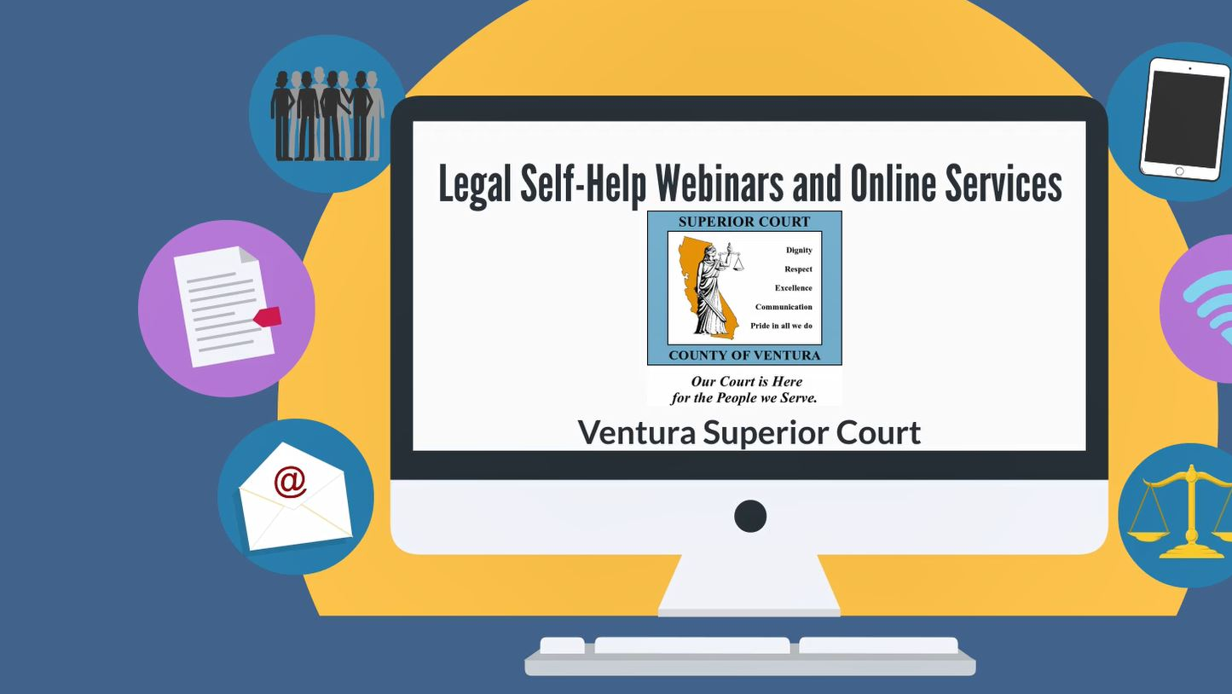
LEGAL SELF-HELP WEBINARS FISCAL YEAR SNAPSHOT
2018-2019 fiscal year statistical data
VENTURA SUPERIOR COURT

Slide 2
2,807.08 Commuting Hours Saved
175 Legal Self-Help Webinars Conducted
482 Self Represented Litigants Assisted
140,888 lbs of CO₂ Emissions Reduced
Zero Complaints – Zero Wait Time
22 U.S. States and Territories Reached

Slide 3
Family Law Facilitator's Office conducted 147 webinars in FY 18-19
Self-Help Legal Access Center conducted 28 webinars in FY 18-19

Slide 4
FY 18-19 WEBINAR TOPICS
Divorce/Legal Separation/Nullity
Family Law Q&A
How to File a Request for Order
Civil Law Q&A
What to Expect at an Eviction Trial
Civil Forms Review

Slide 5
WEBINAR PARTICIPATION
Statistical data to improve webinar services

Slide 6
FY 18-19 SRL Webinar Participation

Slide 7
FY 18-19 Webinar Participation
1st Quarter numbers are low because our webinars started the last month of the 1st quarter (September 20, 2018).
4th Quarter numbers are low in part because:
Staff vacations and Court holidays.
Self-Help Centers Reconfiguration/Remodel projects to streamline physical operations and complement innovation grant projects.
Innovations Self-Help Court Attorney, Self-Help Assistant and second Digital Content Specialist positions have not been consistently filled. Applicants declined our offers based on the positions being fixed-term. This led to both self-help supervisors and two staff attorneys taking on additional duties. In turn, this led self-help staff taking on additional workloads during walk-in services. Nevertheless, we were able to make our program a success. These hardships will continue if we are to sustain these vital online services.

Slide 8
FY 18-19 SRL Residency Data

Slide 9
Residency Categories Defined
Ventura County – West: Oxnard, Ventura, Pt. Hueneme, Camarillo, Pt. Mugu, Oak View, and Ojai.
Ventura County – East: Newbury Park, Moorpark, Simi Valley, Westlake Village, Santa Paula, Fillmore, Oak Park, Thousand Oaks.
Outside Ventura – within CA: Santa Barbara, Alameda, California City, Carpentaria, Chino Hills, Concord, Downey, Santa Rosa, El Cajon, Escondido, Bakersfield, Costa Mesa, Encinitas, Glendale, Hanford, Lancaster, Lompoc, Long Beach, Los Angeles, Irvine, Pacoima, Petaluma, Santa Ana, Sausalito, Sacramento, Salinas, San Clemente, San Francisco, Santa Clarita, Santa Maria, Santa Monica, Van Nuys, and Victorville.
Outside State of CA: Arizona, Nevada, New Jersey, Georgia, Pennsylvania, North Carolina, Maryland, Minnesota, South Dakota, Colorado, New Mexico, Tennessee, Kansas, Texas, Ohio, Washington, Wyoming, Puerto Rico, Virginia, Utah, and Hawaii

Slide 10
WEBINAR FEEDBACK
Statistical data to improve webinar services

Slide 11
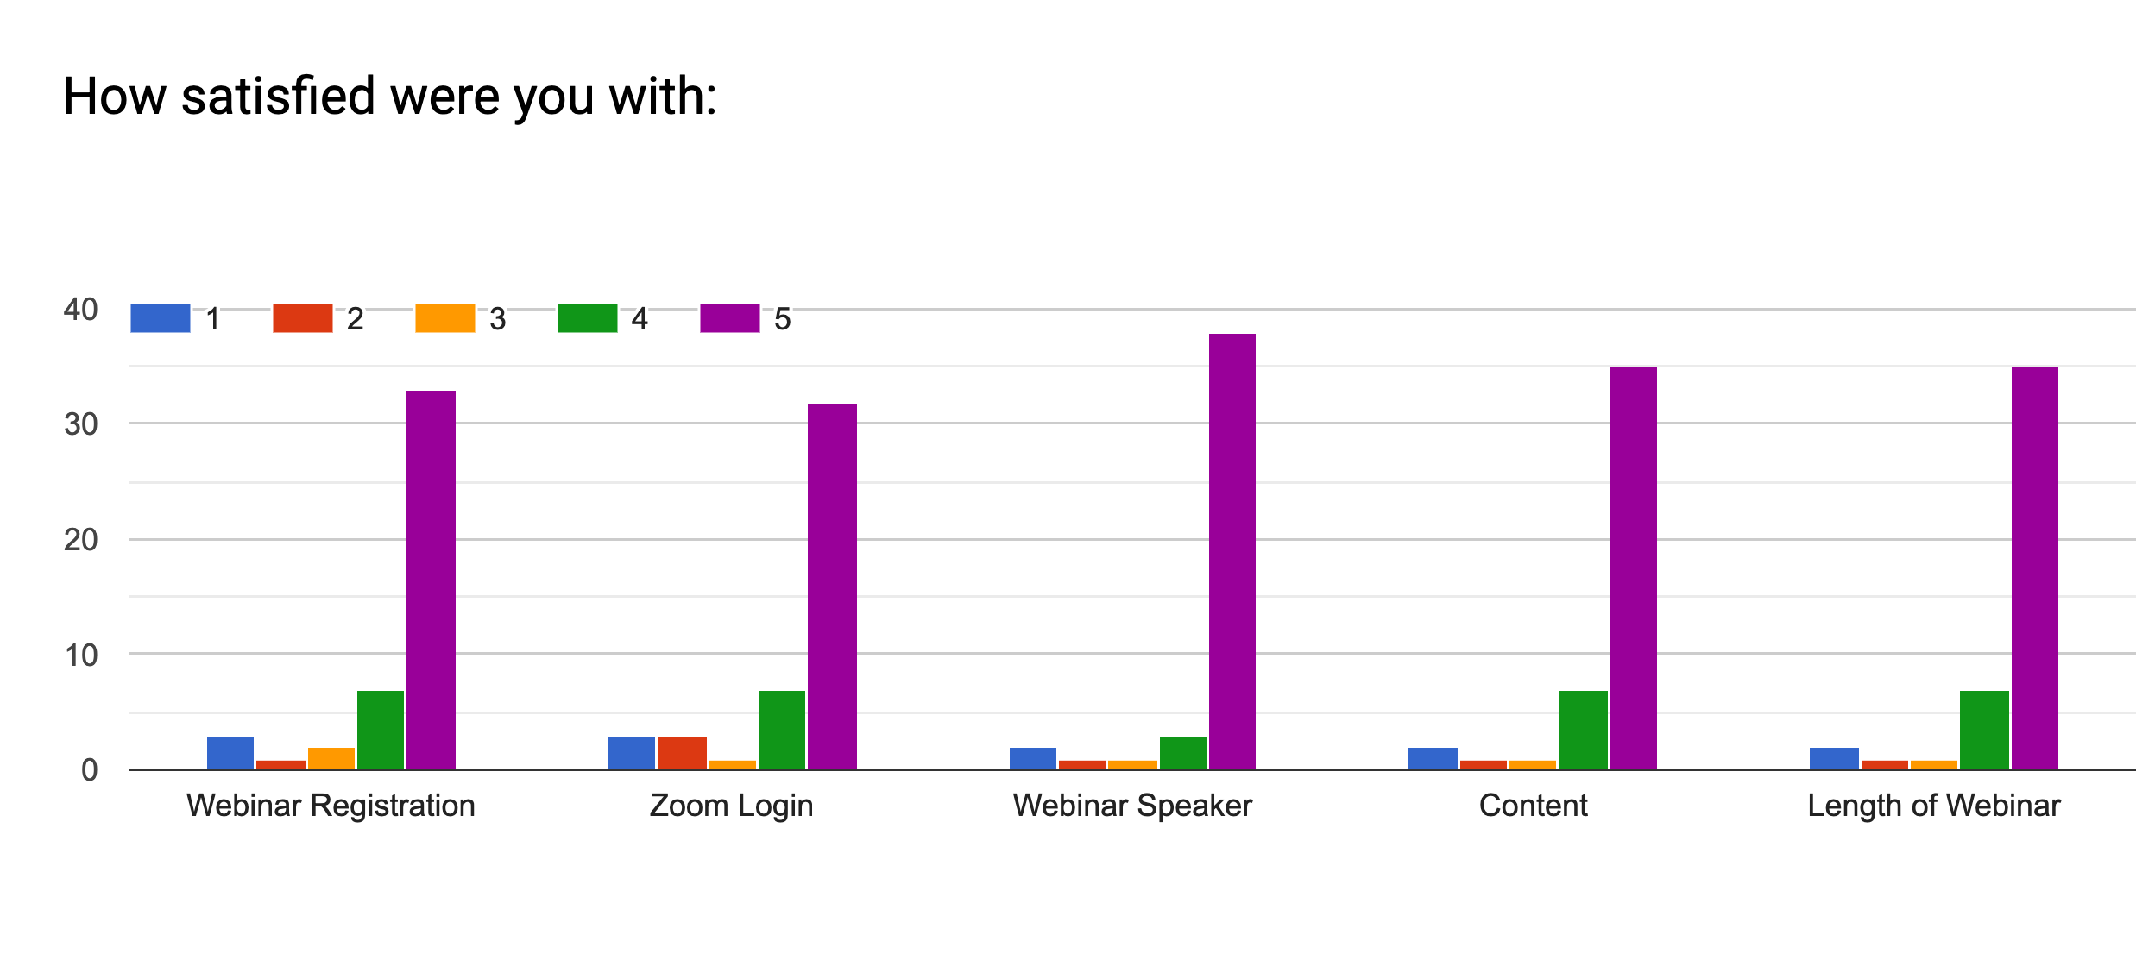
WEBINAR FEEDBACK
IMMEDIATELY FOLLOWING WEBINAR
Very dissatisfied
Very satisfied

Slide 12
Have you ever received assistance at a Ventura Self-Help Center?

Slide 13
How did you hear about our webinars?

Slide 14
Do you prefer self-help assistance online or in person?

Slide 15
WEBINAR FEEDACK
COMPARING WALK-IN SERVICES AND WEBINARS
Goal: Ensure same quality of services across all modes of self-help services
47% preferred our webinars over walk-in services
Goal: Continue to collect and analyze measurable outcome data to identify areas of improvement
Yet walk-in services demand continue to increase
47% preferred both
3,818 SRLs sent away in FY 18-19

Slide 16
Did the webinar meet your expectations?
Yes. It was very helpful. Provided good details.
Thank you for offering these webinars.
Thank you for providing a service like this. Using zoom slideshow to go along with the speaker’s dialogue made it easy to comprehend. I’m definitely feeling more informed and confident with moving forward.
Yes. Pourya was thorough and provided great explanations to questions. Also kept us on the subject at hand so we would understand.
Everything explained was a HUGE help in my court filing process. Without this opportunity I for sure would have made a mistake and made my process GREATLY lengthy. Thank you.

Slide 17
Did the webinar meet your expectations?
The webinar was very thorough and beneficial. At first, when trying to complete and gather the forms myself it seemed very overwhelming. But after the listening to the webinar it clarified a lot of questions and inquiries that I had.
It was so much better than having to and deal with parking and security and long lines, I was relaxed in my own environment. I had all the materials at hand. I still human interaction, but I didn't have to wait in a line or drive anywhere.
It's really convenient for those of us who have busy schedules or who can't make it there physically. I am currently going to school full-time, and my schedule has me on campus throughout the day.
Both are helpful. I like online because my schedule is very hectic and it was nice to still get help from home.
Yes. The facilitator gave me step by step instructions, and answered my questions in details. Far exceeded my expectation.
This is great! Don't stop having these!

Slide 18
AFTER PARTICIPATION FEEDBACK
SIX WEEKS AFTER WEBINAR PARTICIPATION
83% felt more prepared with filing their court forms because they participated in a webinar
91% felt more prepared for their court hearing because they participated in a webinar

Slide 19
WHERE DO WE GO FROM HERE?
Continue to record our webinars for quality improvements.
Find ways to increase interest in SHLAC webinars.
Create a new Self-Help Website with instinctual navigation and interactive interface.
Expand HotDocs and Legal Self-Help videos to our website
Expand collaborative efforts with state and local partners.
Utilize Digital Content Specialist to address digital/technical challenges and improve webinar quality.
Start exploring sources of funding for sustainability of webinars post grant award.

Slide 20
RESOURCES
http://www.ventura.courts.ca.gov/
https://calendly.com/vcselfhelpcenter
https://forms.gle/DG9dXH6SgFqmpeu86
https://zoom.us/j/6876882129
https://zoom.us/j/9233414675
https://www.vyond.com/

Slide 21
QUESTIONS
Alfonso Martinez
Managing Attorney – Professional Services
Ventura Superior Court
800 South Victoria Avenue, Room 307
Ventura, CA 93009
805-289-8737
Alfonso.Martinez@ventura.courts.ca.gov

