Slide 1
Court Interpreter Data Collection System (CIDCS) Court Interpreter Portal Instructions for payment of the compliance annual renewal fee and attestation
September 2023

Slide 2
How to pay the annual renewal fee and attest to completion of the continuing education and professional assignments requirements
These instructions outline four easy steps:
Step 1. Log into the CIDCS Interpreter Portal
Step 2. Select the “Professional Assignments and Continuing Education” tab to attest (if due by December 31, 2023)
Step 3. Select the “Payment History” tab to pay the $100 annual renewal fee
Step 4. Save the two confirmation emails

Slide 3
Step 1 Log into the CIDCS Interpreter Portal
Interpreter Portal:
https://interpreterportal.courts.ca.gov/index.cfm

Slide 4
Step 2 Select the “Professional Assignments and
Continuing Education” tab.

Slide 5
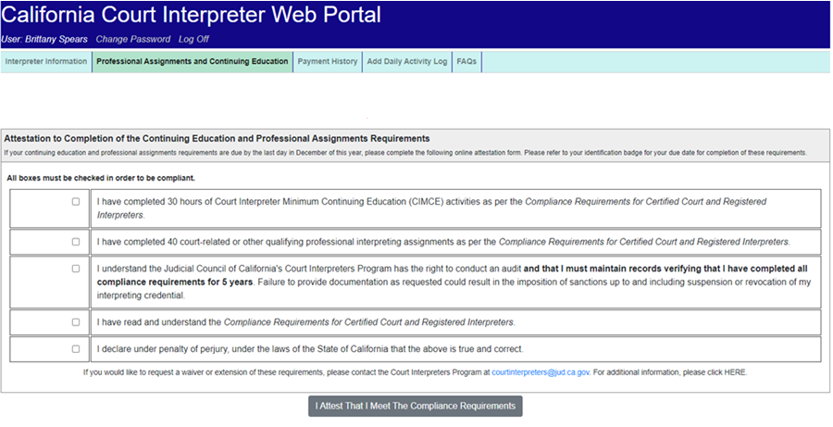
If your professional assignments and continuing education requirements are due by December 31, 2023, you will see this screen. You must select every checkbox and then click on “I Attest That I Meet the Compliance Requirements” before proceeding to payment. Be sure to keep records for five years in case of an audit.

Slide 6
You are not required to attest by December 31, 2023, if you see the circled message. You may proceed to make a payment by clicking on the “Payment History” tab.

Slide 7
Step 3 Select the “Payment History” tab.

Slide 8
The table provides important information about the compliance deadlines and fees. Select “Click here to make a payment by credit or debit card” to make a payment.

Slide 9
The fee(s) that you owe and the transaction fee will be listed in the table shown below. Select “Proceed to Checkout” to make a payment.

Slide 10
Payment page
The system only accepts Mastercard , Visa, and debit cards with these logos. Provide all of the required information and then submit your payment by clicking on “Pay with Your Credit or Debit Card.”
NOTE: For your security, the system will NOT retain your card’s information.

Slide 11
Once payment is complete, you will be logged out of CIDCS. Note: You may log back in at anytime to update your profile information.

Slide 12
Step 4 You will immediately receive two email confirmations. Save them for your records.
CIDCS Confirmation
Payeezy Confirmation

Slide 13
To view your history of payments (including the payment just made), log back in and select the “Payment History” tab.
Insert screen shot of payment history screen.

Slide 14
Additional Information
Waivers
Other Fees
If you need to request a waiver due to hardship, please contact the Court Interpreters Program at:
courtinterpreters@jud.ca.gov
Late fees for compliance can also be paid via the Interpreter Portal when due.
Fees for new and replacement badges can also be paid via the Interpreter Portal by emailing the Court Interpreters Program

Slide 15
Resources
For more information about the CIDCS Interpreter Portal: https://www.courts.ca.gov/44714.htm
For more information about compliance:
https://www.courts.ca.gov/23507.htm
For help logging in: Email CIDCS@jud.ca.gov
For questions about compliance: Email courtinterpreters@jud.ca.gov

