Slide 1
For the Public Good
How Attorneys Improve the Justice System Through Pro Bono Services
Notes:
Opening slide
NEXT SLIDE

Slide 2
“Pro bono publico - ‘for the public good’ - not just in the sense of professional work undertaken voluntarily and without payment, but in the sense of a public service to those who are unable to afford the services of skilled professionals. It is a noble and necessary calling for all attorneys.” – California Supreme Court Chief Justice Tani G. Cantil-Sakauye
Notes:
As lawyers, you are members of an honorable profession, with a proud history of pro bono legal services. With the privilege of law practice comes the obligation to ensure that our system is accessible to the most vulnerable among us. By doing pro bono work, you are not only helping the vulnerable, you are also improving the administration of justice. Systems have been put in place across the state to facilitate pro bono service. These systems—offered by pro bono organizations, legal services programs, local bar associations, and court-based self-help centers—make it easy for you to volunteer by offering training, connecting you with individuals in need who have already been interviewed to determine their legal issues and financial eligibility, and helping with the necessary follow-up to ensure quality services for that client.
NEXT SLIDE

Slide 3
Judicial Leaders Recognize the Importance of Pro Bono Work
Notes:
Our judicial leaders have long recognized the importance of pro bono work to our communities and strongly urge an increase in pro bono work.
Since 1989 the State Bar’s Board of Trustees has urged all California attorneys to provide at least 50 hours of pro bono services per year to the poor or nonprofits.
In 1996 the California Judicial Council issued a Resolution on Pro Bono, outlining its commitment to working jointly with the Bar to promote pro bono throughout the state. In 2011, the Judicial Council resolved that each October would be recognized as Campaign for Justice Month, and that each year the last week of October would be recognized as National Pro Bono week.
The judicial branch understands how busy and hardworking attorneys are and has intentionally set a very reasonable minimum pro bono goal for each attorney. The goal of 50 hours of pro bono services per year is achievable. If all attorneys strived to reach this goal, as a state we could make major inroads on our collective promise of providing access to justice for all Californians.
NEXT SLIDE

Slide 4
Pro Bono Helps Clients and Our Community
Notes:
Here’s how your pro bono services benefit the individual client as well as our wider community:
When a pro bono lawyer helps keep a family in their home, it prevents them from becoming homeless and from creating an additional demand on shelters and other charitable and municipal services.
When a pro bono lawyer helps keep a child in school, truancy and juvenile crime are reduced, saving court time and reducing the costs of incarceration.
When a pro bono lawyer helps a senior remain in his or her home with supportive care, the much higher cost associated with full nursing home care is avoided.
NEXT SLIDE

Slide 5
Legal Aid Has Limited Capacity
Notes:
Legal Services programs, also known as Legal Aid, are non-profit law firms providing legal representation, advice, and policy advocacy work. Legal Aid clients are typically very low income. Because of their funding structures, legal aid programs primarily serve clients with annual incomes of less than 125% of the federal poverty limit. Legal aid offices serve many senior citizens and adults with disabilities. In 2014, a household of one had to have annual earnings of less than $14,588 to qualify for legal aid services. Most legal aid clients belong to households with minor children. In 2014, a household of four had to have annual earnings of less than $29,813 to qualify for legal aid’s help.
In 2011, close to 7 million Californians had annual incomes of less than 125% of the federal poverty limit. There are simply not enough legal aid attorneys to assist all of these families.
As of 2014, there was less than one legal services attorney for every 10,000 indigent people in the United States. As California Supreme Court Justice Goodwin Liu said, “That means if you filled Qualcomm Stadium to its capacity, you'd have seven lawyers to serve all of them….And if they gave each client just 30 minutes, it would take them seven months to meet with everybody, and that's working around the clock, 24/7, without breaks.” Justice Liu went on to say that, “ It's no wonder the majority of low-income people in our country don't bother to seek a lawyer, even when they have a very serious problem. To lower these barriers to justice, we all have to do our share and then some.”
Because they are under-resourced, Legal aid agencies in California must turn away more than two-thirds of eligible prospective clients who need assistance each year. The one-third who do get assistance do not necessarily receive the level of service they require, and many get only brief advice and counsel.
NEXT SLIDE

Slide 6
California IOLTA Income from 2000 - 2013
Notes:
Legal aid programs receive the bulk of their funding from three sources, The Legal Services Corporation (or LSC), the Interest on Lawyers Trust Accounts (also known as IOLTA), and The Equal Access Fund. Due to budget shortfalls in recent years, many legal services offices operate with inadequate staffing, have reduced their client intake hours, and are forced to scale back on services.
When the funds in a lawyer’s client trust account cannot earn enough income for the client to be more than the cost of securing that income, the funds are collected in an IOLTA account, pooled together throughout the state, then distributed to California’s civil legal aid programs. In 2008, Federal interest rates suddenly plummeted to nearly zero, reducing the IOLTA funding stream from about $22 million to a 2014 estimate of less than $5 million annually. Legal aid programs were devastated by this reduction. Most programs instituted hiring freezes while some were forced to lay off staff.
In the meantime, funding from the Legal Services Corporation (LSC) has been substantially flat. Although the federal government has increased LSC funding over the last decade, this funding has not kept up with inflation nor with population increases. California has been hit particularly hard by this stagnate funding as our public’s need for legal aid services has continued to grow. Despite innovative and diligent work to reverse funding deficits, California legal aid programs are still treading water.
NEXT SLIDE

Slide 7
Court-Based Self-Help Centers Have Limited Capacity
Notes:
Judicial Officers constantly see vulnerable low-income families and seniors attempting to handle their own serious legal matters. We are pleased that all of our superior courts now have self-help centers to help with serious family law matters. But the centers are understaffed, and there will always be individuals who need a lawyer to provide more than self-help assistance.
Currently, over 1.2 million Californians seek assistance annually from court–based Self-Help Centers. The majority of these Californians are trying to address fundamental concerns of family law, housing, guardianship of children, protection from interpersonal violence, and consumer matters. 75% of Self-Help Center users report having jobs, yet still cannot afford to hire attorneys.
Some Self-represented are moderate income and small businesses that cannot afford legal counsel.
Many court users have disabilities which make self-representation difficult, but the reality is that self-representation is often the only option for these court users.
Over 20% of Californians have limited English proficiency; for many of these court users self-representation is an inadequate option, but without the ability to afford an attorney it is their only option.
NEXT SLIDE

Slide 8
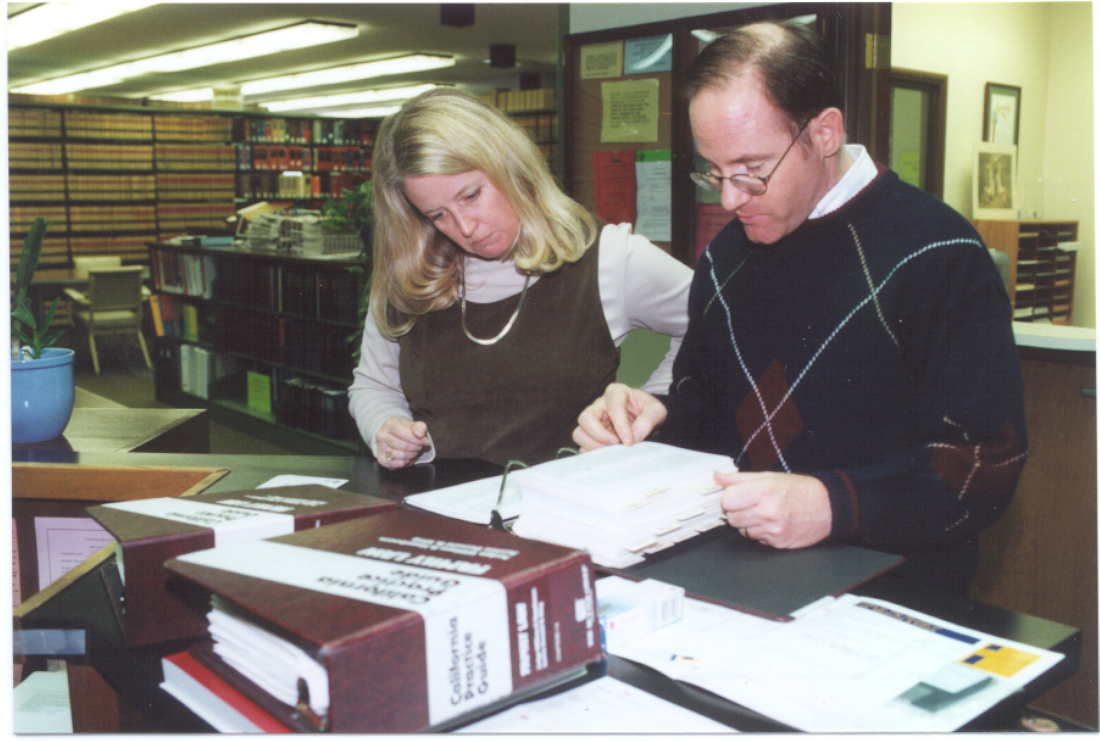
Referral Services and Law Libraries Have Limited Capacity
Notes:
Lawyer Referral Services provide referrals, organized limited-scope representation panels, and other services to moderate income litigants who cannot afford the cost of traditional representation. But these programs need far more attorneys willing to provide reduced-cost services and limited scope representation.
County law libraries are often the last and only option to obtain legal information. But many law libraries, which traditionally targeted resources to attorneys, have reduced hours due to budget cuts and lack the funds to provide the self-help publications and computer programs that our court users need access to.
NEXT SLIDE

Slide 9
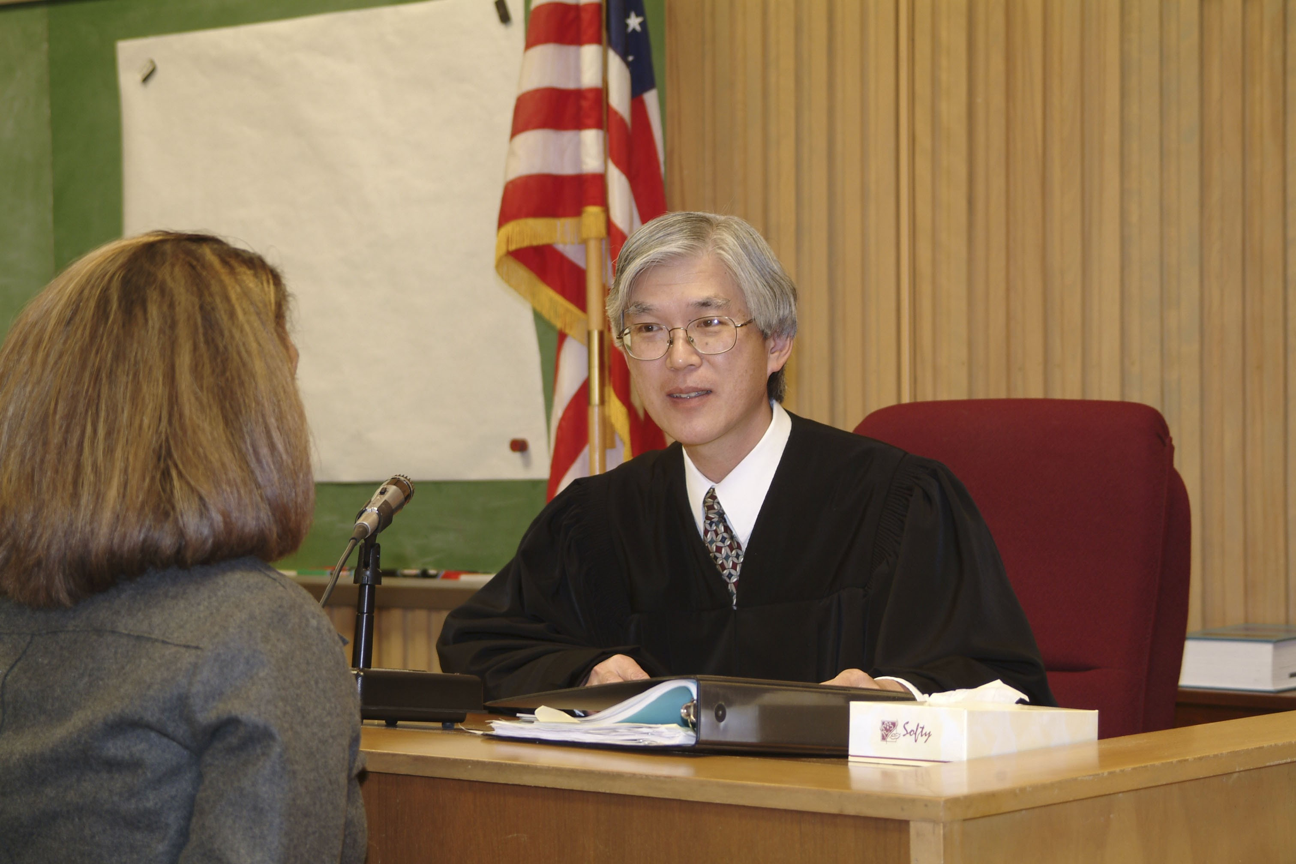
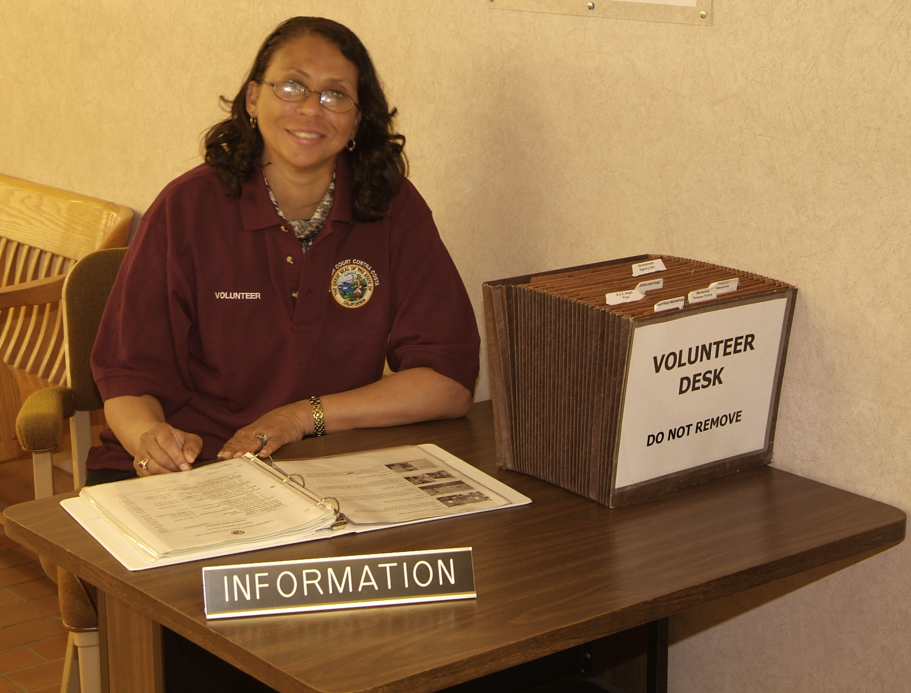
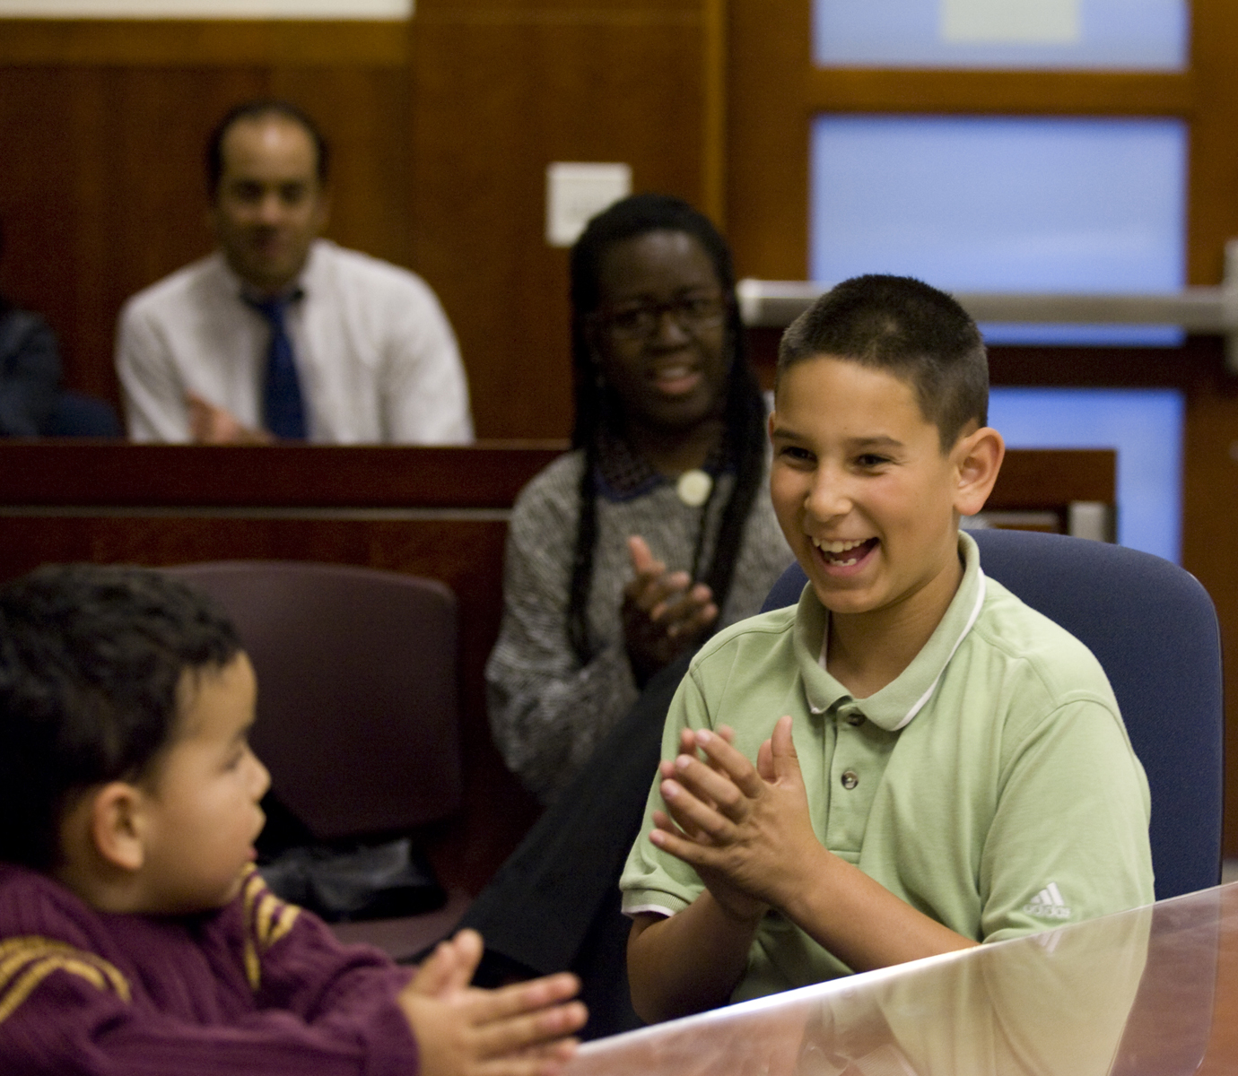
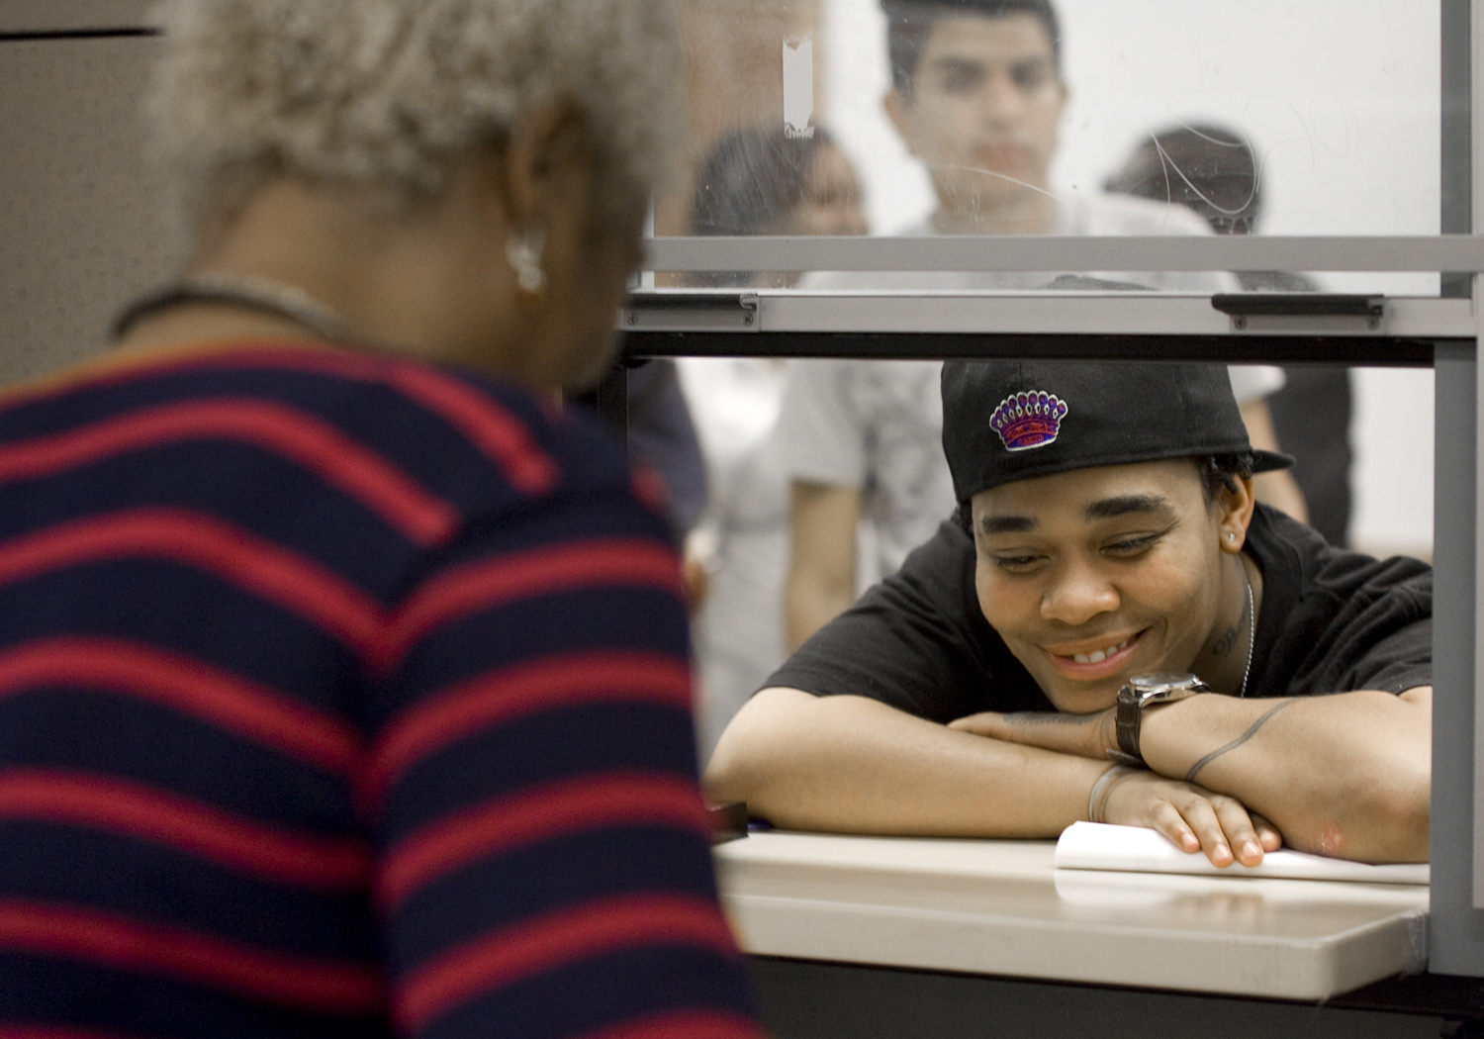
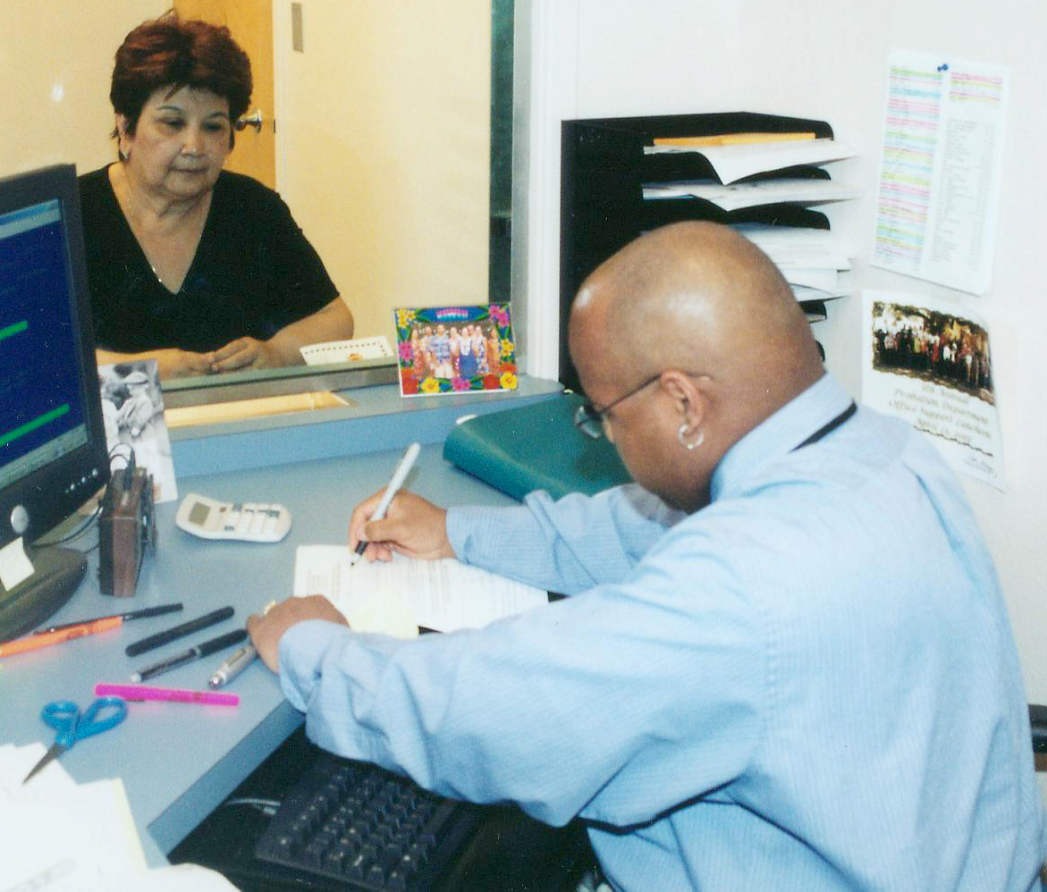
Pro Bono Benefits the Courts
Notes:
Legal aid programs, court self-help centers, lawyer referral services and law libraries are all working hard, often in collaboration, but cannot come close to meeting the full need of our state’s low-income families. California is relying on the talented attorneys in our communities to join the effort so that our state can meet these critical needs.
Your pro bono service benefits the courts by bono ensuring meaningful access to justice to millions who need legal representation but cannot afford it. You help our courts operate more efficiently and effectively through your pro bono contributions. When you provide pro bono service, you also improve public perception of the legal profession in invaluable ways.
NEXT SLIDE

Slide 10
Pro Bono Service Makes Business Sense
Notes:
Pro bono service makes business sense for attorneys, from all types of firms, large and small, public and private, and for solo practitioners as well.
All attorneys can benefit from pro bono work by developing skills and expertise and creating contacts in the community. Pro bono providers offer Minimum Continuing Legal Education (MCLE) trainings for prospective volunteers at little or no cost, as well as opportunities to network with other lawyers. Many Pro bono programs provide mentoring and malpractice coverage for their volunteers.
Law firm corporate clients are interested in evidence of their lawyers’ corporate social responsibility. Annual law firm rankings in publications such as The American Lawyer have had a positive impact on firms’ pro bono practices.
NEXT SLIDE

Slide 11
Types of Pro Bono Work
Full Representation
Limited Scope Representation
Impact litigation and policy advocacy
Transactional legal assistance to nonprofits
Legal information at court self-help centers
Advice and Counsel clinics and hotlines
Notes:
Pro bono opportunities exist in all areas of civil law. There are many ways to perform pro bono work and varying levels of time commitment. They include:
Full representation
Limited Scope representation
Impact litigation
Policy advocacy
Transactional legal assistance to nonprofit organizations
Advice and counsel clinics and hotlines
Providing legal information at court self-help centers
Mediation of legal disputes, and
Community education and outreach
NEXT SLIDE

Slide 12
Get Involved
Join bar association pro bono program
Contact local legal aid program
Work with your firm’s pro bono manager
Contact your court’s self-help center
Visit www.CaliforniaProBono.org
Notes:
No matter what kind of lawyer you are, whether you are just graduating from law school or have been licensed for decades, California needs your pro bono service. Are you working as litigator, transactional lawyer, mediator, law professor, government employee, or solo-practitioner? The judicial branch needs your support in this pro bono effort. You may be a retired attorney or one who has stepped away from practice to care for family or to pursue other passions. You have all earned the title of “Lawyer”. Each and every one of you has specialized education, training, and skill-sets that our communities need.
So get involved:
Join your local bar association’s pro bono program;
Contact your local legal aid other non-profit legal services program;
Work with your firm’s pro bono manager or partner;
Contact your court’s self-help center; and
Visit CaliforniaProBono.org to find opportunities in your location and areas of interest.
NEXT SLIDE

Slide 13
California Thanks You!
Pro Bono Service
Notes:
I leave you with this final quote from United States Supreme Court Justice Ruth Bader Ginsburg. “Lawyers have a license to practice law, a monopoly on certain services. But for that privilege and status, lawyers have an obligation to provide legal services to those without the wherewithal to pay, to respond to needs outside themselves, to help repair tears in their communities.”
Speaking for myself and my judicial colleagues, we thank you sincerely for your help. We know that you have incredible demands on your time. Your commitment to the profession and to the courts is truly appreciated.
NEXT SLIDE

