Slide 1
Pathways to Justice
Small Claims Basics
William T. Tanner
Directing Attorney – Legal Aid Society of Orange County
06/10/2015

Slide 2
Outline
Preliminary questions:
Are you suing a person or business?
How will you name them?
Person
Corporation
Doing business as, “DBA”
Catalyst Loans
How will you serve them?

Slide 3
SC-100: Plaintiff’s Claim and Order to Go to Small Claims Court

Slide 6
Naming: Plaintiff

Slide 7
Naming: Defendant

Slide 8
Damages

Slide 9
Serving
Serving
1. CCP 116.340
a. Within the State
i. Except car accident
ii. Real property
2. Personal
3. Substituted
4. CCP 1962
5. B&P Code

Slide 12
Venue

Slide 13
SC-104: Proof of Service

Slide 16
Service

Slide 17
Service

Slide 18
Service

Slide 19
Service

Slide 20
Service
Service Issues:
Certified Mail
2. Friend
3. Sheriff
4. Process Server

Slide 21
EJ-130: Writ of Execution

Slide 22
Collection
Collecting
1. Person
a. Wages
b. Bank account
c. Real property lien
2. Business
a. Bank account
b. Cash register
i. Till tap
ii. Keeper

Slide 25
Collection

Slide 26
Collection

Slide 27
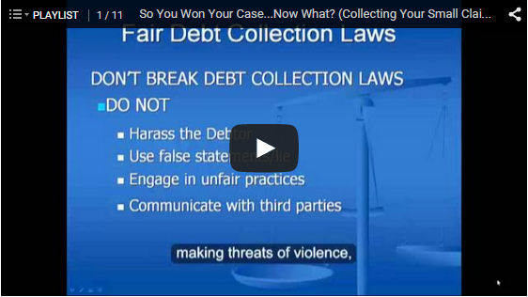
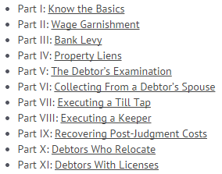
www.ocsmallclaims.com

Slide 28
Questions

