Slide 1
Limited Conservatorship of the Person
Limited Conservatorships are specifically designed for Developmentally Disabled Adults.
There are 7 powers for a Limited Conservatorship.
It is up to you which of the 7 powers you want to ask for. You can ask for some or all of them.
It is up to the Judge to grant some, none, or all of the 7 powers that you request.

Slide 2
Limited Conservatorship of the Person
1. To fix the residence or specific dwelling of the person;
2. To have access to the confidential records and papers of the person, including,
but not limited to, Regional Center documents and school records;
3. To consent or withhold consent to the marriage or the entrance into a registered domestic
partnership by the person;
4. To control the right of the person to contract;
5. To give or withhold consent to medical treatment for the person;
6. To control the person’s social and sexual contacts and relationships; and
7. To make decisions concerning the person’s education.

Slide 3
Today’s Presentation
The purpose of today’s presentation is to make sure that all of the information on your forms is true and correct.
The following slides show a sample completed petition.
The boxes checked on the sample petition are not necessarily the same ones that will be checked on your petition.
You should review your draft petition carefully, and make sure that you understand why boxes were or were not checked.
If any boxes on your petition are not correct or if you have any questions, please ask for help.

Slide 4
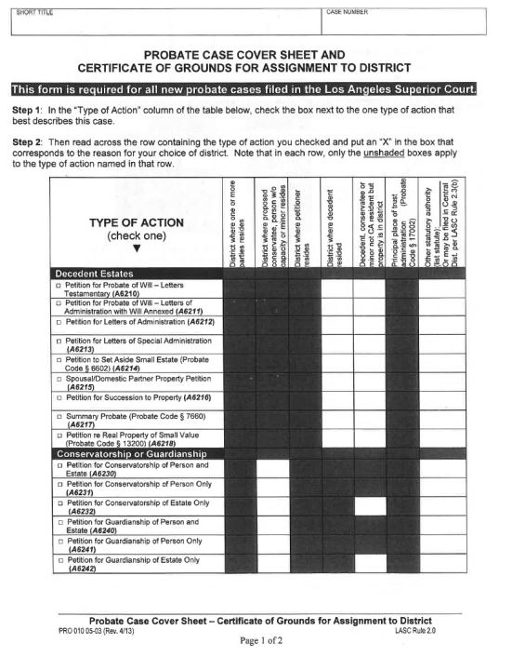
SAMPLE ONLY
Probate Case Cover Sheet

Slide 5
Page 1 of 2
Conservatorship of (Conservatee’s Name)
SAMPLE ONLY

Slide 6
SAMPLE ONLY

Slide 7
SAMPLE ONLY

Slide 8
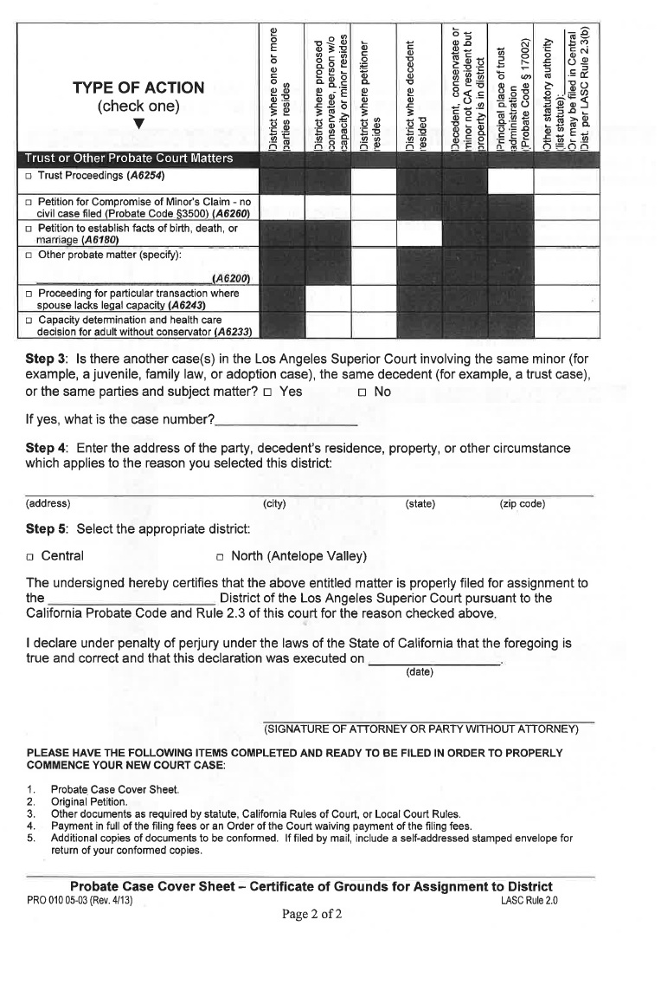
Page 2 of 2
SAMPLE ONLY
X

Slide 9
SAMPLE ONLY
X
Conservatee’s Address
City State Zip Code
OR
Central or North
Today’s Date
Petitioner’s Signature

Slide 10
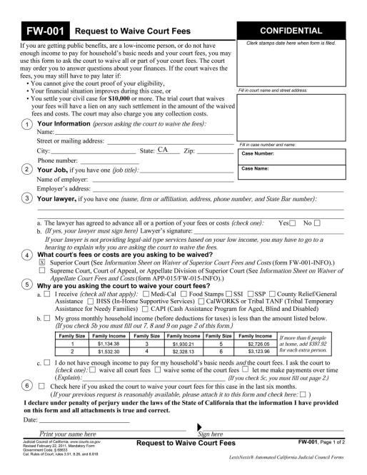
SAMPLE ONLY
Request to Waive Court Fees

Slide 11
Page 1 of 2
SAMPLE ONLY
Court
Petitioner’s Name
Petitioner’s Address
City
Zip
Petitioner’s Phone
Conservatee’s Name

Slide 12
SAMPLE ONLY

Slide 13
SAMPLE ONLY
Date
Petitioner Name, based upon income of proposed conservatee
Petitioner Sign Here

Slide 14
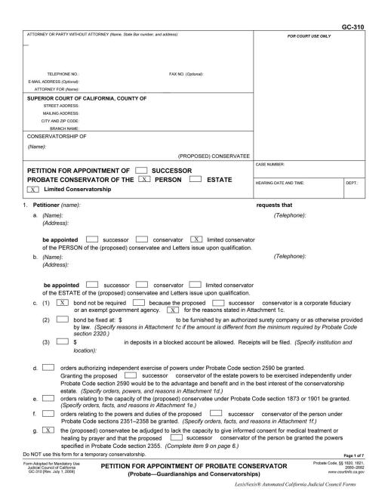
Petition For Appointment of Probate Conservator
SAMPLE ONLY

Slide 15
Page 1 of 7
SAMPLE ONLY
Petitioner’s Name
Petitioner’s Address
Petitioner’s Phone
Petitioner’s Name, Petitioner in Pro Per (BT/XX)
Court
Conservatee’s Name
Petitioner’s Name
Conservator’s Name/Names
Petitioner’s
Phone
Petitioner Address

Slide 16
SAMPLE ONLY

Slide 17
SAMPLE ONLY

Slide 18
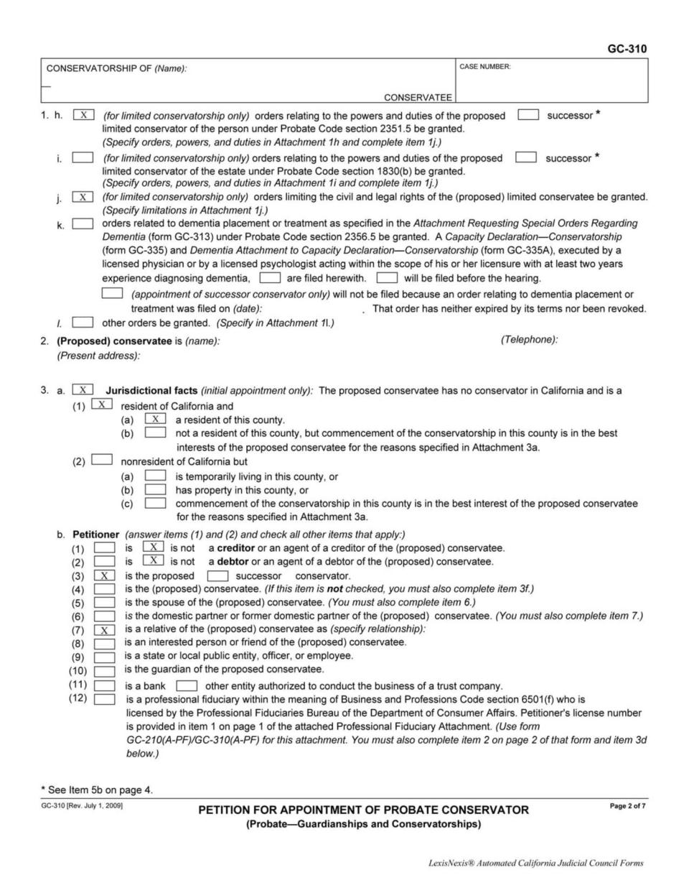
Page 2 of 7
SAMPLE ONLY
Conservatee’s Name
Conservatee’s Name
Conservatee’s Address
Conservatee’s Phone

Slide 19
SAMPLE ONLY

Slide 20
SAMPLE ONLY
OR
OR
if box (7) is checked, fill in
check
all
that
apply
[
Petitioner’s relationship

Slide 21
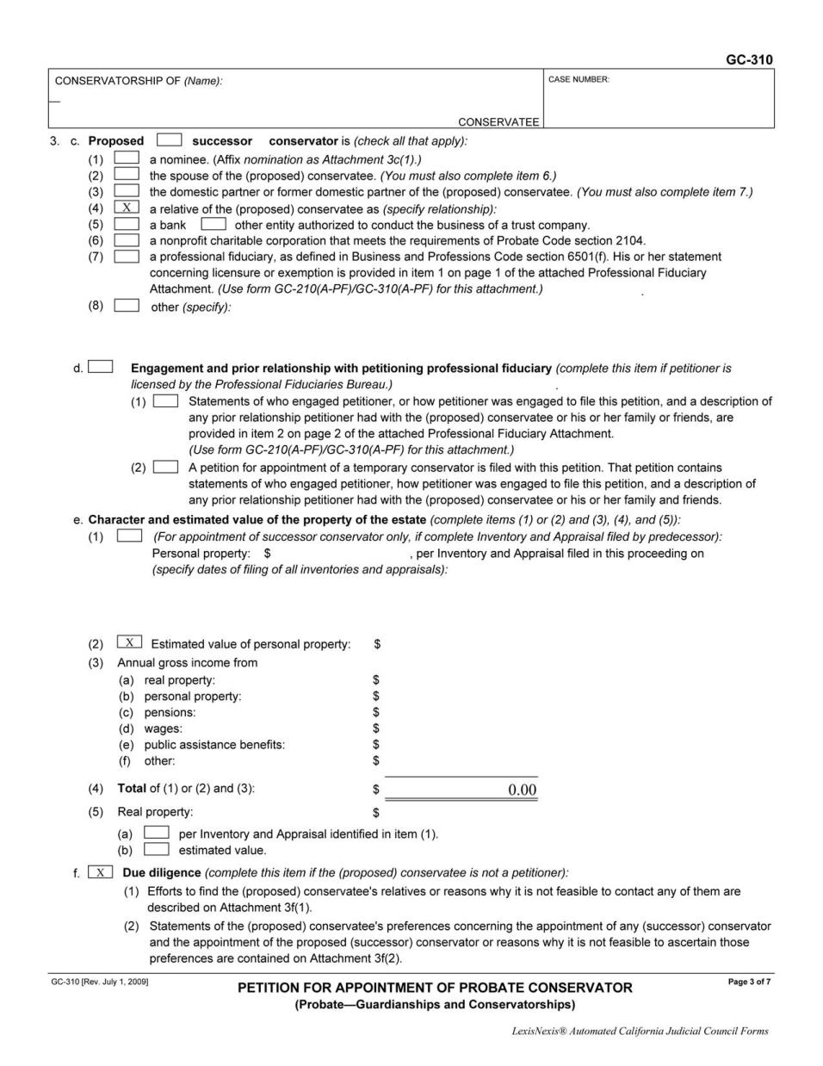
Page 3 of 7
SAMPLE ONLY
Conservator’s relationship

Slide 22
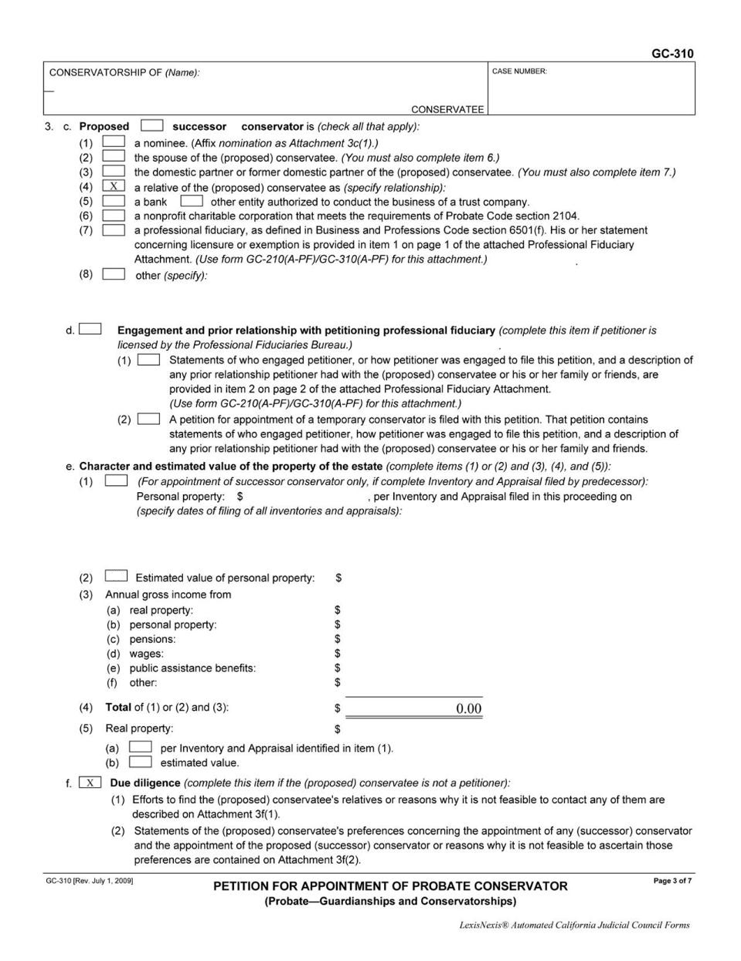
Page 3 of 7
SAMPLE ONLY

Slide 23
SAMPLE ONLY

Slide 24
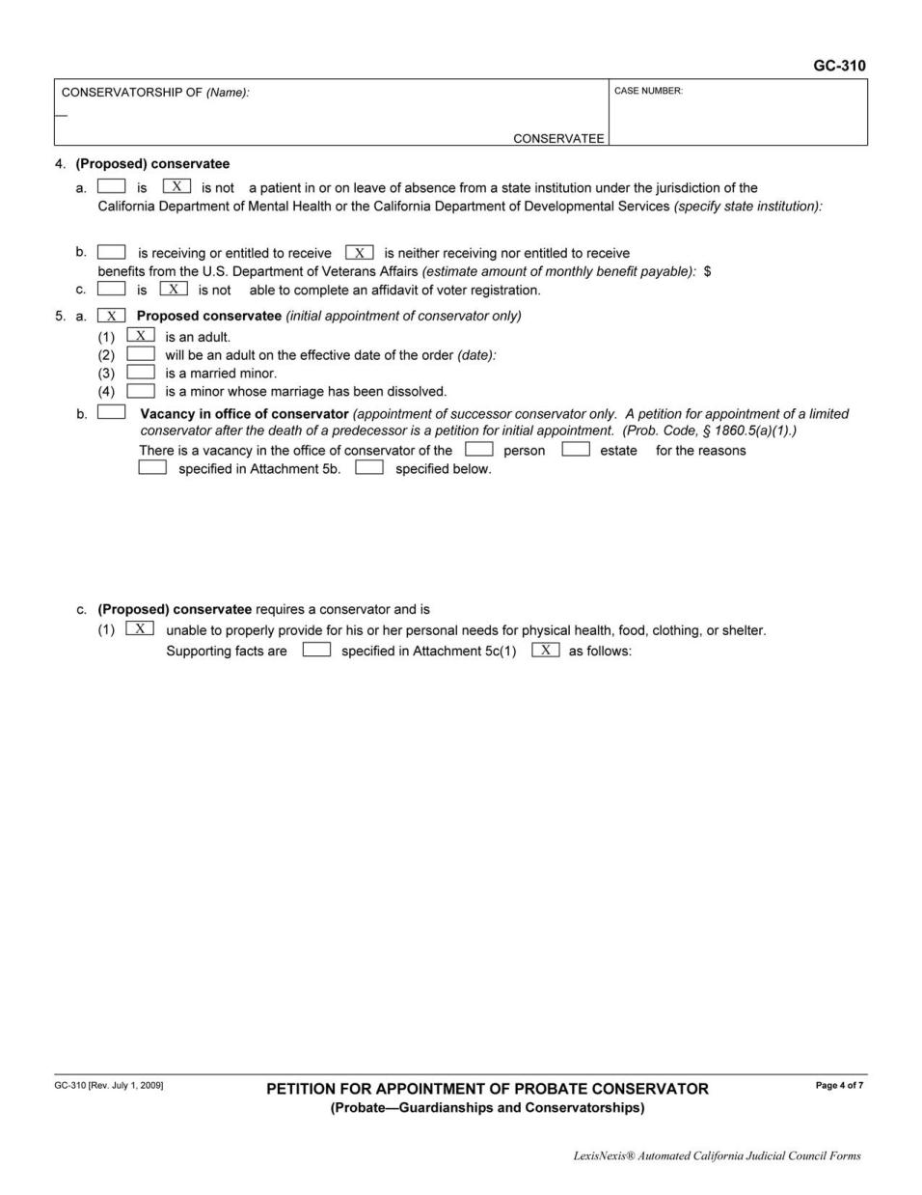
Page 4 of 7
SAMPLE ONLY
OR
OR
OR
If proposed conservatee is able to complete
an affidavit of voter registration, check “is”
If (2) is checked, fill in:
If proposed conservatee is able to complete
an affidavit of voter registration with help,
check “is” and see Attachment 4c
OR
birthdate when will turn 18 years-old
If unable, check “is not”

Slide 25
SAMPLE ONLY

Slide 26
SAMPLE ONLY
A paragraph describing why conservatee needs a conservatorship.

Slide 27
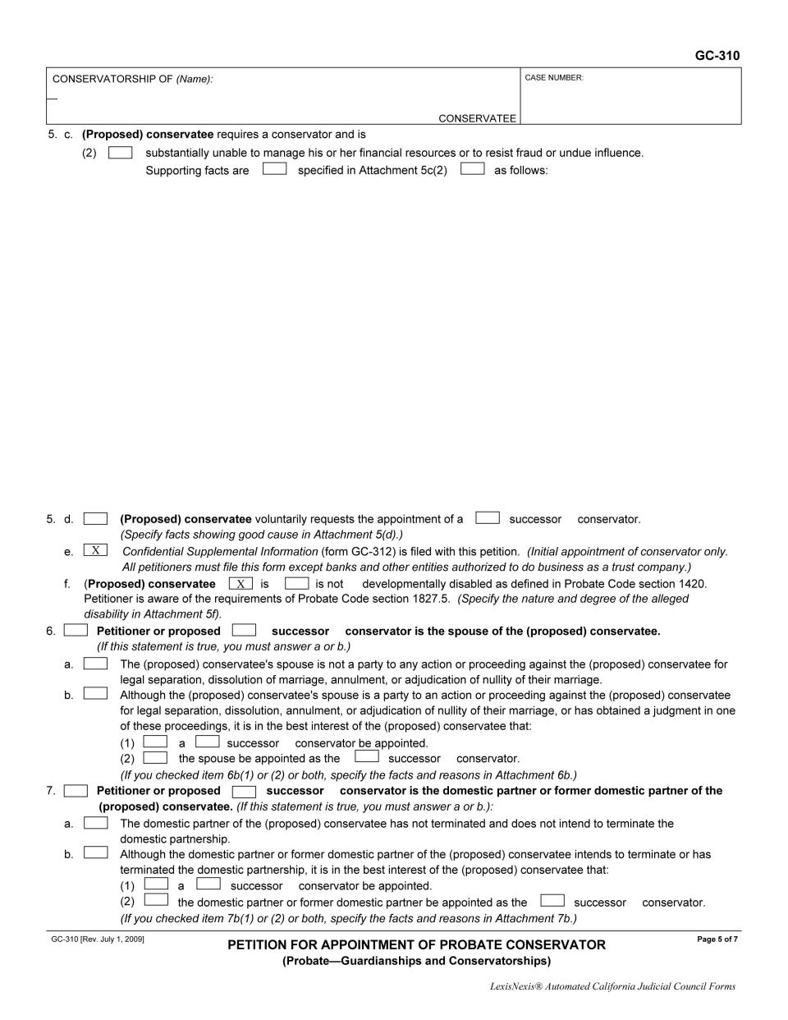
Page 5 of 7
SAMPLE ONLY

Slide 28
SAMPLE ONLY

Slide 29
SAMPLE ONLY

Slide 30
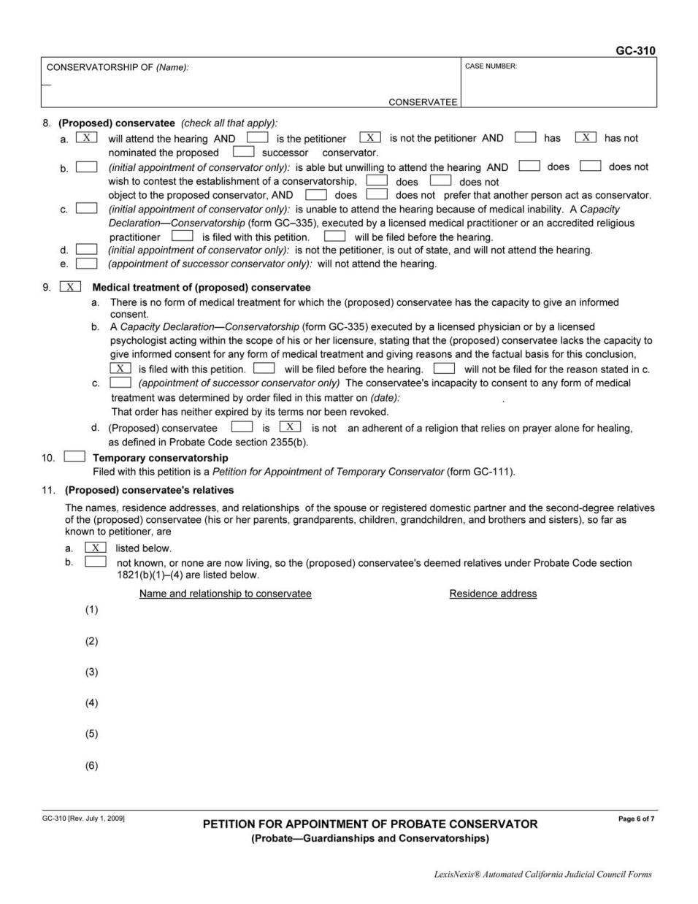
Page 6 of 7
SAMPLE ONLY
OR
OR
OR
OR

Slide 31
SAMPLE ONLY

Slide 32
SAMPLE ONLY
Relative’s Name and Relationship Address
Required Relatives are all people over the age of 12
related to the Conservatee by the 2nd Degree
Examples: Father, Mother, Brother’s and Sisters (Including Half), Grandparents, and children if they have any.
Relative’s Name and Relationship Address
Relative’s Name and Relationship Address
Relative’s Name and Relationship Address
Relative’s Name and Relationship Address
Relative’s Name and Relationship Address

Slide 33
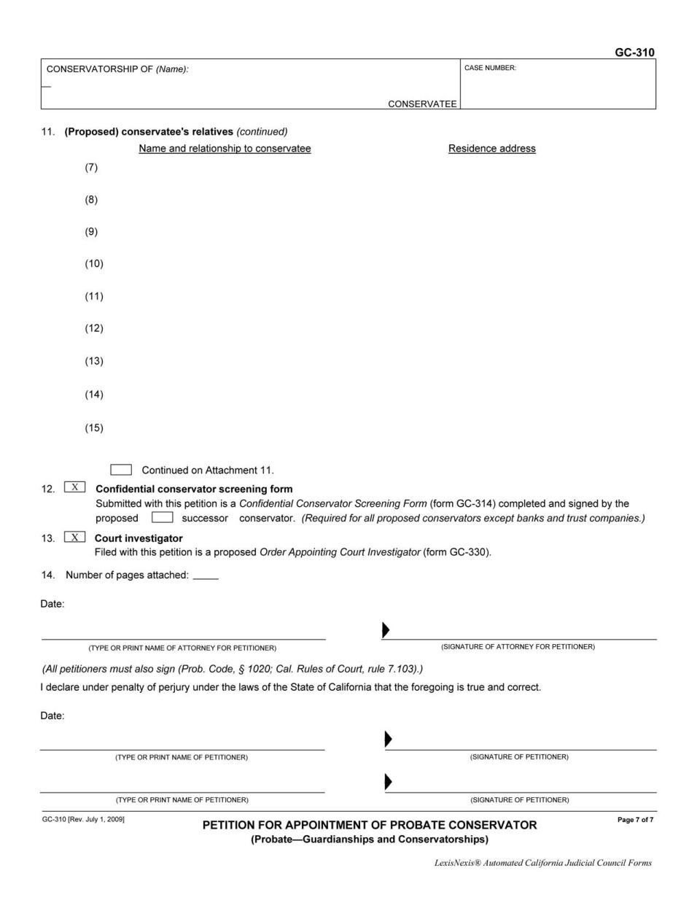
Page 7 of 7
SAMPLE ONLY
Relative’s Name and Relationship Address
Relative’s Name and Relationship Address
Relative’s Name and Relationship Address
Relative’s Name and Relationship Address
Relative’s Name and Relationship Address
Relative’s Name and Relationship Address
Relative’s Name and Relationship Address
Relative’s Name and Relationship Address
Relative’s Name and Relationship Address

Slide 34
SAMPLE ONLY

Slide 35
SAMPLE ONLY
Date
Petitioner Name
Petitioner Sign Here
Date
Petitioner Name
Petitioner Sign Here

Slide 36
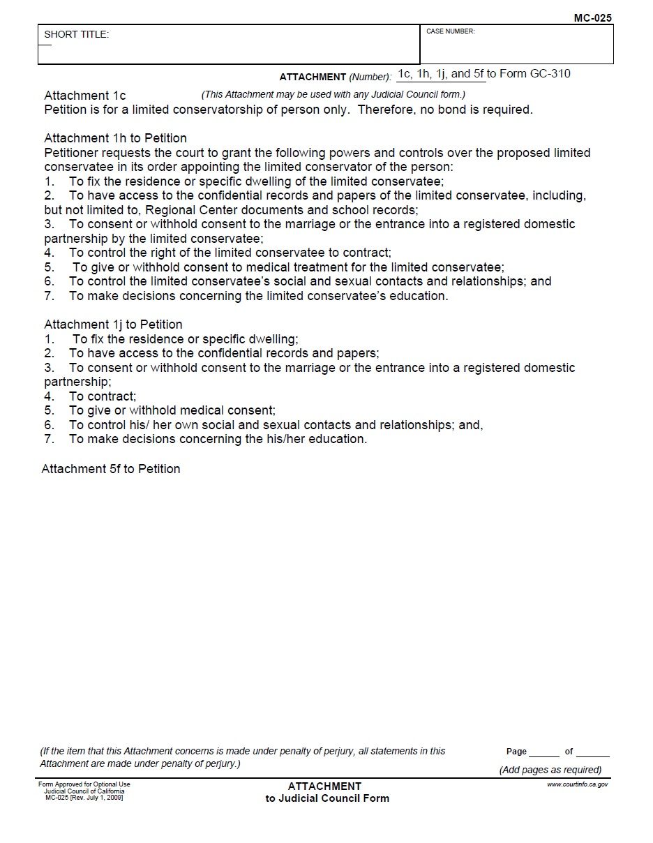
Attachment to Petition
SAMPLE ONLY
Conservatee’s Name

Slide 37
Attachment to Petition
SAMPLE ONLY

Slide 38
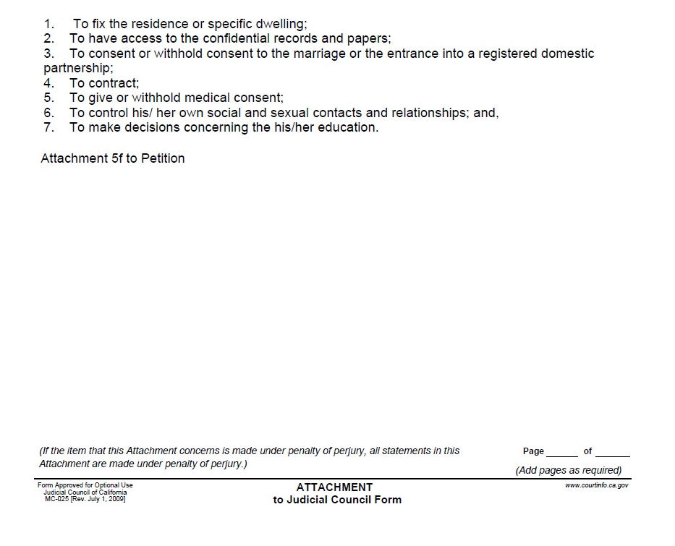
SAMPLE ONLY
Conservatee’s Diagnosis Here

Slide 39
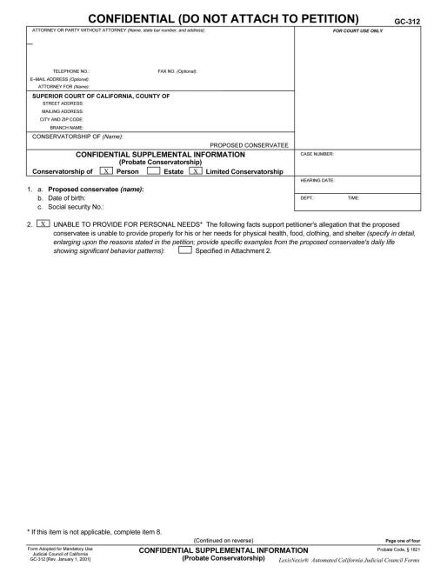
SAMPLE ONLY
Confidential Supplemental Information

Slide 40
Page 1 of 4
SAMPLE ONLY
Petitioner’s Name
Petitioner’s Address
Petitioner’s Phone
Petitioner’s Name, Petitioner in Pro Per (BT/XX)
Court
Conservatee’s Name
Conservatee’s Name
Conservatee’s Date of Birth
Conservatee’s Social Security Number
A paragraph describing why conservatee needs a conservatorship.

Slide 41
SAMPLE ONLY

Slide 42
SAMPLE ONLY
SAMPLE ONLY

Slide 43
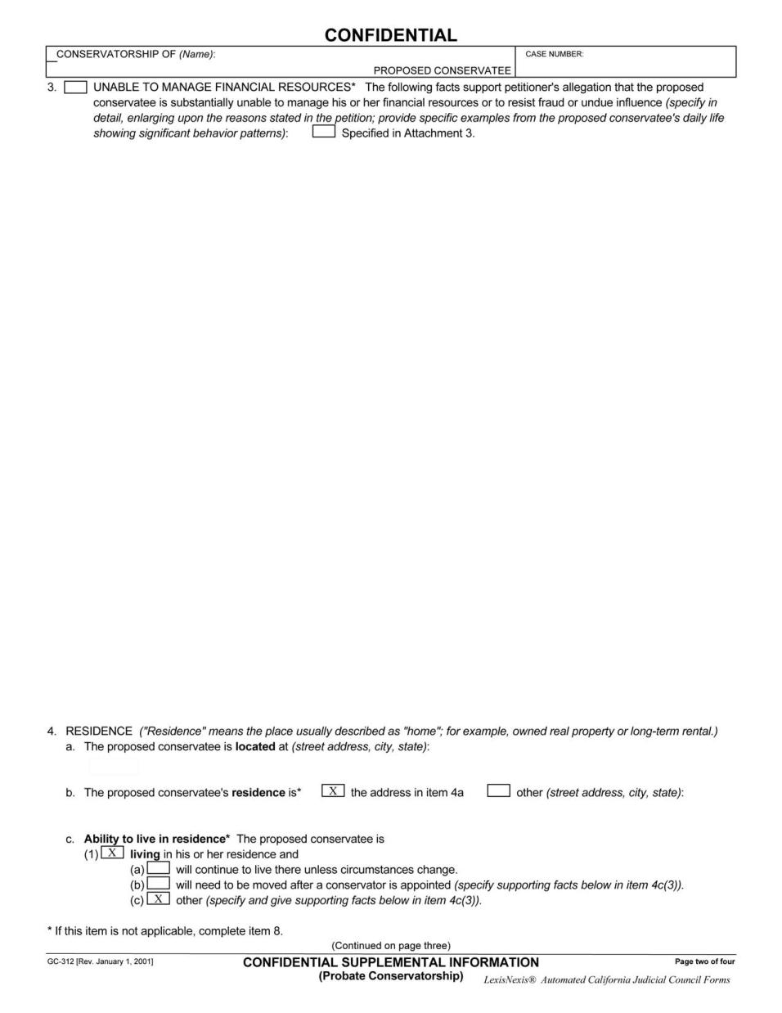
Page 2 of 4
SAMPLE ONLY

Slide 44
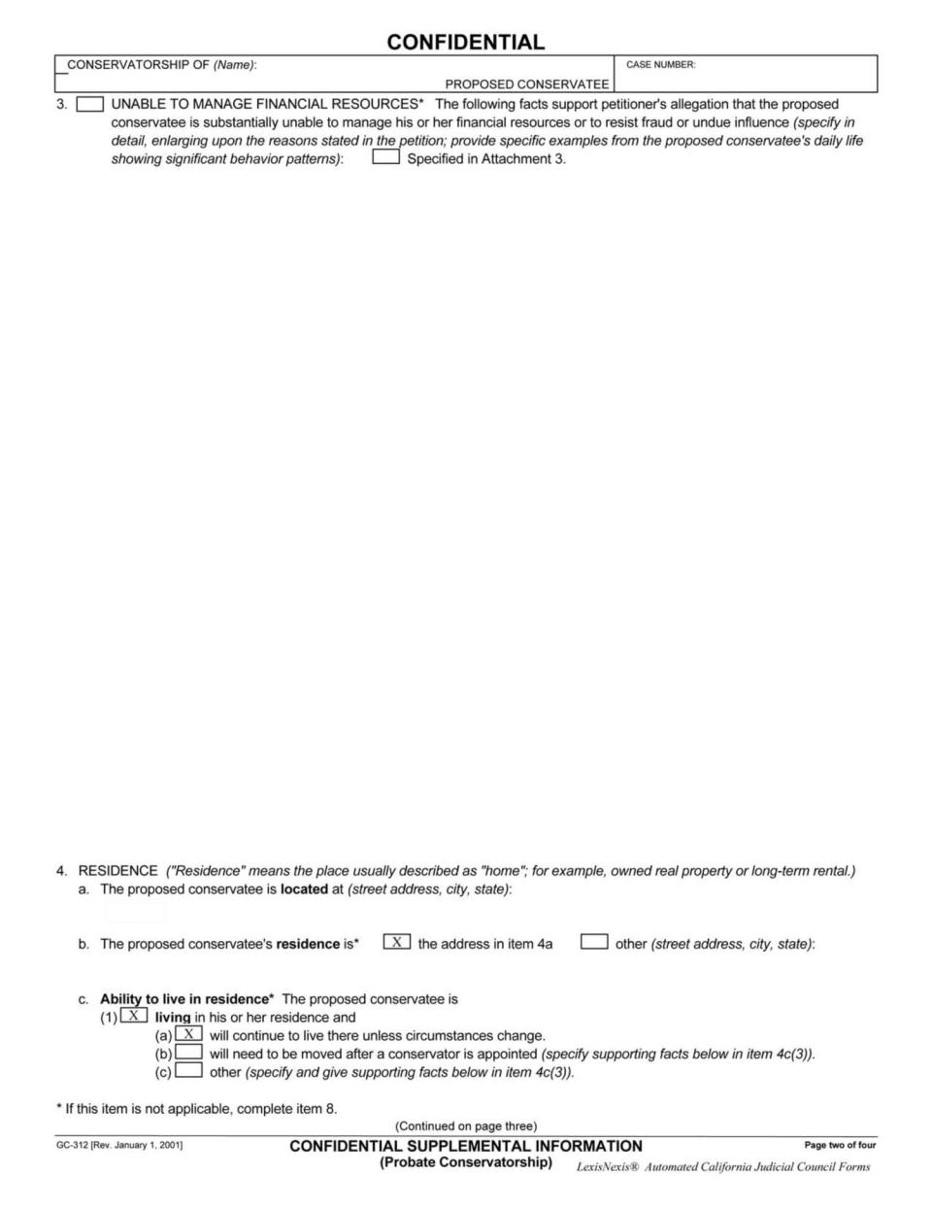
SAMPLE ONLY

Slide 45
SAMPLE ONLY
Conservatee’s Address
OR

Slide 46
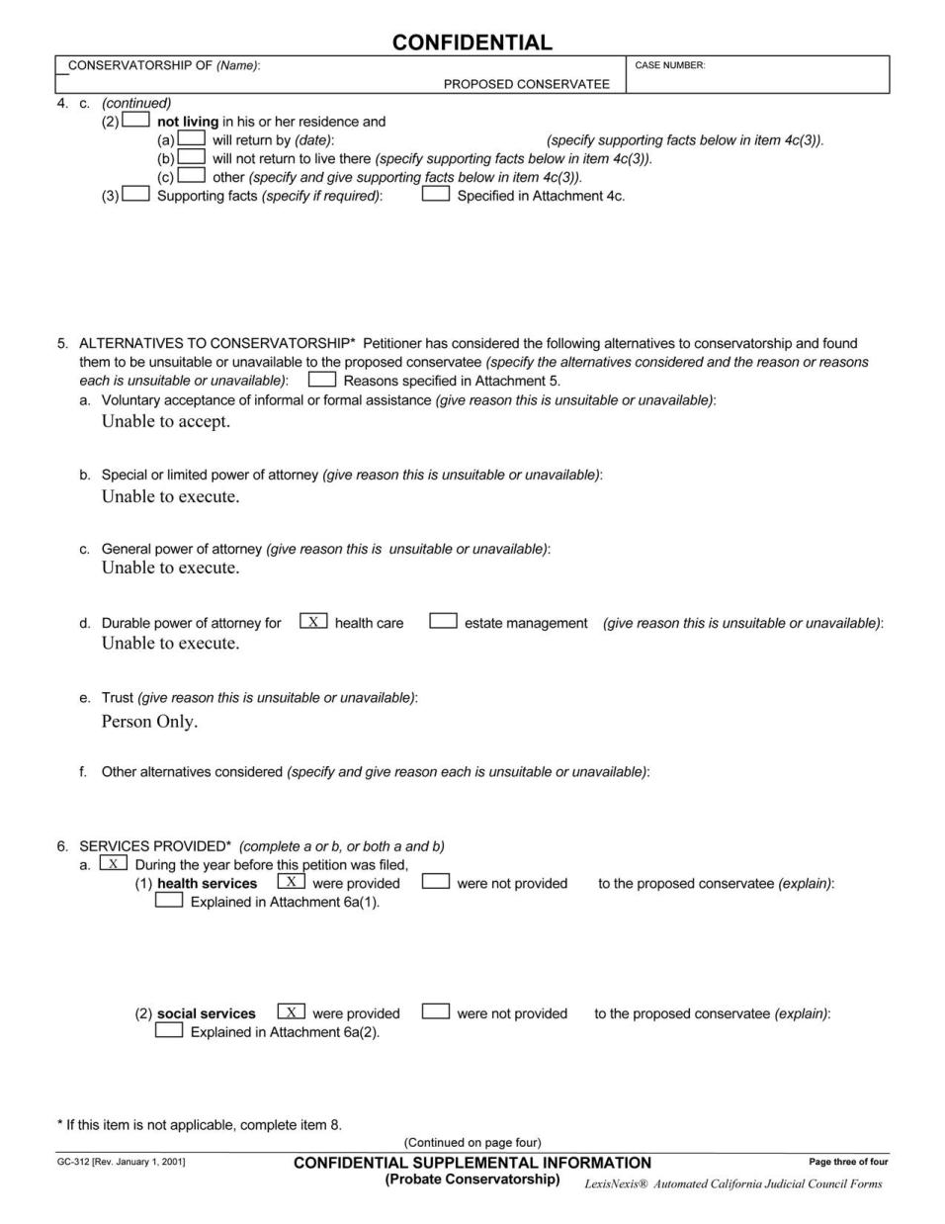
Page 3 of 4
SAMPLE ONLY

Slide 47
SAMPLE ONLY

Slide 48
SAMPLE ONLY
Conservatee’s Doctor Name and Phone Number
Conservatee’s Doctor Address
Conservatee’s Regional Center Worker and Phone Number
Conservatee’s Regional Center Name and Address

Slide 49
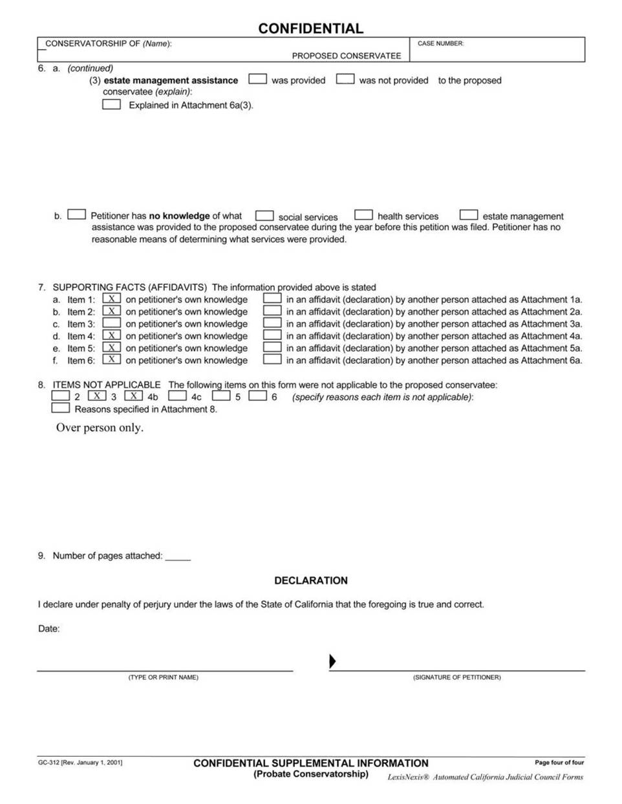
Page 4 of 4
SAMPLE ONLY

Slide 50
SAMPLE ONLY

Slide 51
SAMPLE ONLY
SAMPLE ONLY
Date
Petitioner Name
Petitioner Sign Here

Slide 52
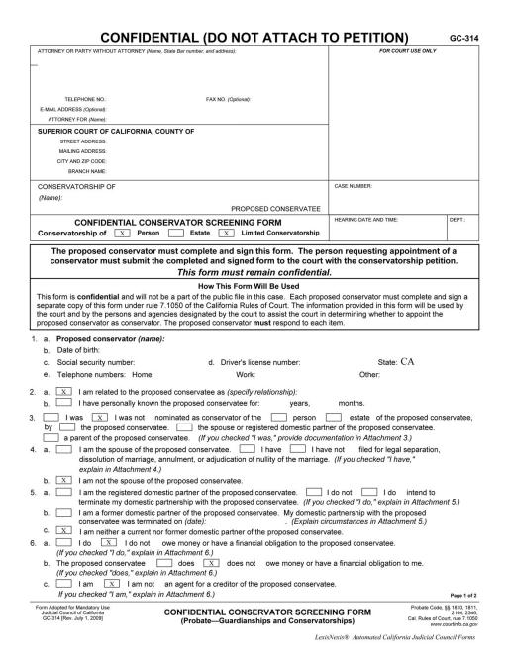
SAMPLE ONLY
Confidential Conservator Screening Form

Slide 53
Page 1 of 2
SAMPLE ONLY
Petitioner’s Name
Petitioner’s Address
Petitioner’s Phone
Petitioner’s Name, Petitioner in Pro Per (BT/XX)
Court
Conservatee’s Name

Slide 54
SAMPLE ONLY

Slide 55
SAMPLE ONLY
Conservator’s Name
Conservator’s Date of Birth
SSN
DL#
Home #
Work #
Other #
OR
If (a): describe relationship to Conservatee
#
#
If (b): fill in years and months
OR
OR
OR

Slide 56
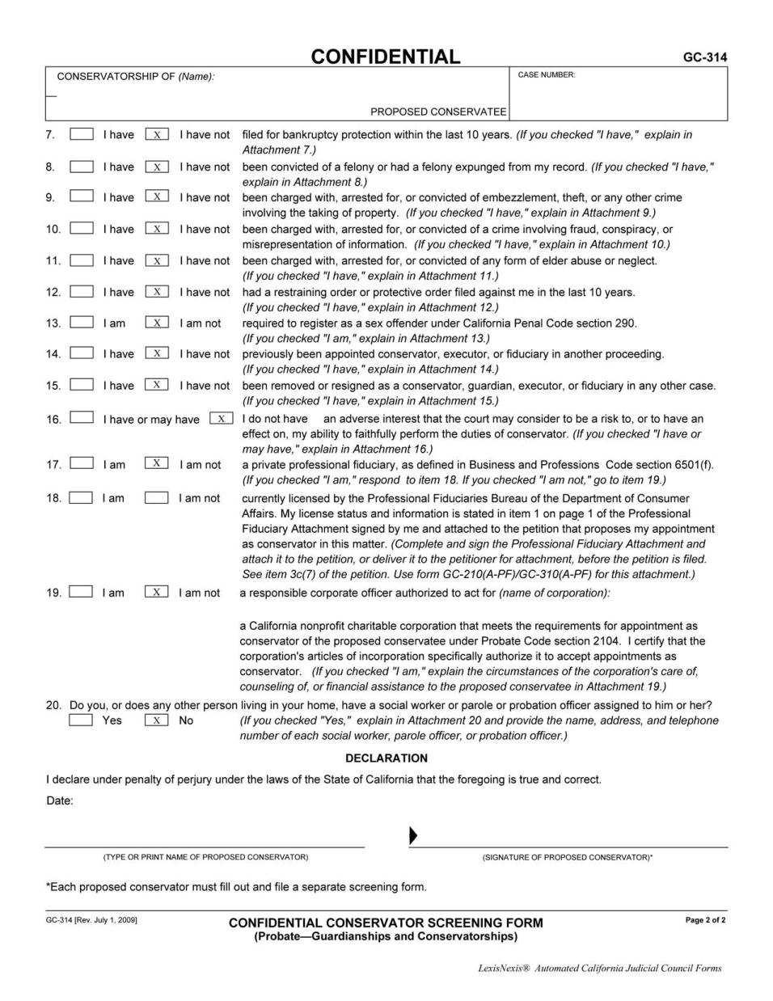
Page 2 of 2
SAMPLE ONLY
OR
OR
OR
OR
OR
OR
OR
OR
OR
OR
OR

Slide 57
SAMPLE ONLY
OR
OR
SAMPLE ONLY
If checked
“I am” for #17, answer #18
If checked,
“I am not” for #17,
leave #18 blank
(skip to #19)
OR
OR
does not include Regional Center Workers
Date
Petitioner Name
Petitioner Sign Here

Slide 58
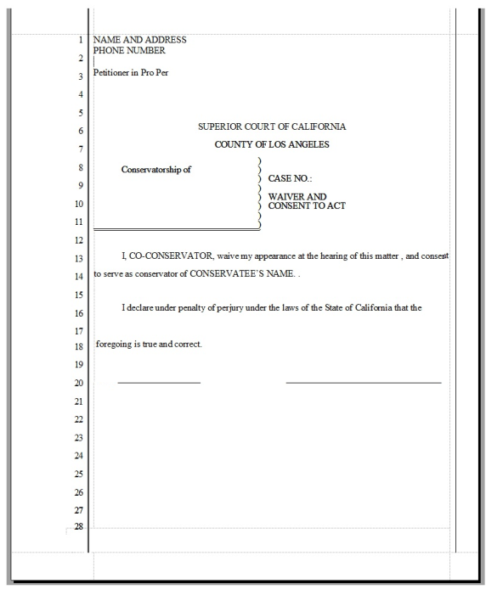
Waiver and Consent Form
SAMPLE ONLY
This form is filled out
by any
Co- Conservator.
It is needed to show
that the Co-Conservator
consents to be
Co-Conservator
over Conservatee.

Slide 59
SAMPLE ONLY
Conservatee’s Name
Date
Signature

Slide 60
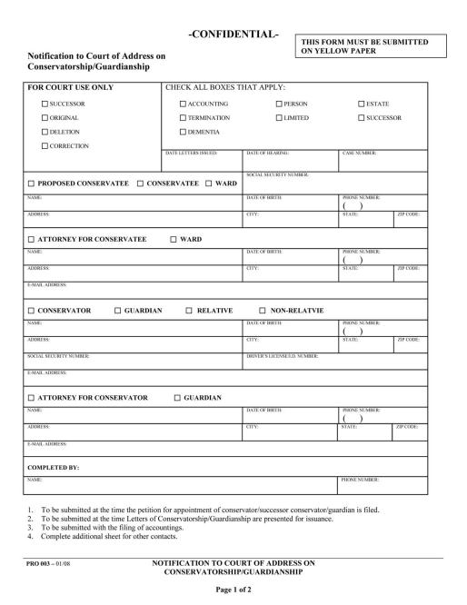
Notification to Court of Address
SAMPLE ONLY

Slide 61
Page 1 of 2
SAMPLE ONLY
Conservatee’s SSN
Conservatee’s Name
Date of Birth
Phone Number
Conservatee’s Street
City
State
Zip

Slide 62
SAMPLE ONLY

Slide 63
SAMPLE ONLY
Conservator’s Name
Date of Birth
Phone Number
Conservator’s Street
City
State
Zip
Conservator’s SSN
Conservator’s DL#
Conservator’s Email Address
Conservator’s Name
Phone Number

Slide 64
If you can, bring your child to the next appointment…
If you bring your child,
we will take care of serving your child
and completing the service papers.
If you do not bring your child,
you will have to find someone else to serve your child
and complete and the service papers yourself.

Slide 65
What Now?
1. Bet Tzedek will file your documents.
2. Bet Tzedek will send notices to all people whose addresses you provided. It is possible that they will receive this notice before you come back for your next appointment.
3. Bet Tzedek will send notice to the Regional Center. You can follow-up with the Regional Center to make sure they received it. The Regional Center must file a report in order to get the Conservatorship.
4. If you did not bring the completed form from the Doctor today, you must bring it to the next appointment.
5. See you at the next appointment!

